Slide 1
Cities and Energy
Zanie Cilliers

Slide 2
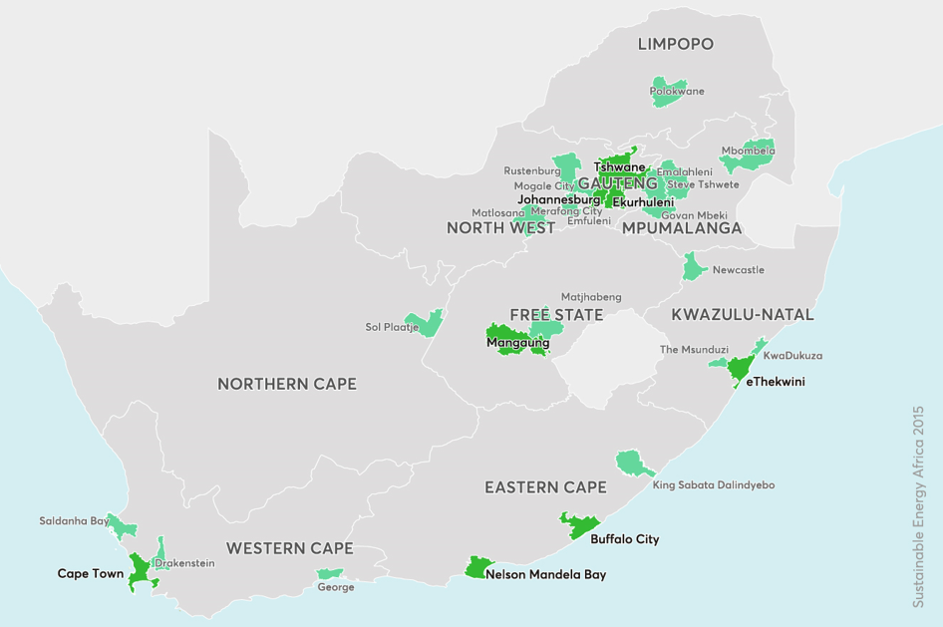

Slide 3
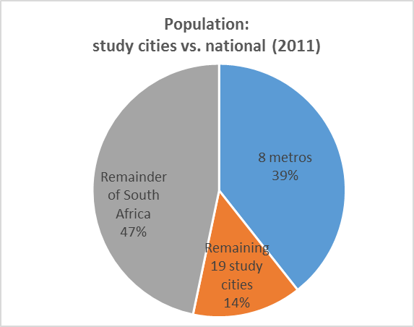
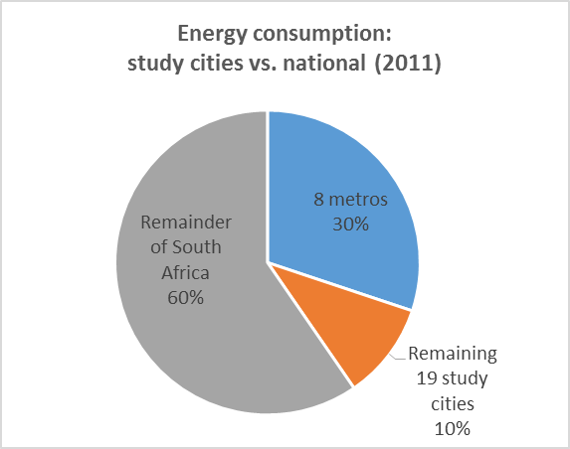
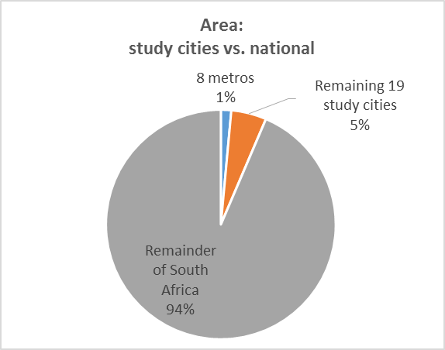
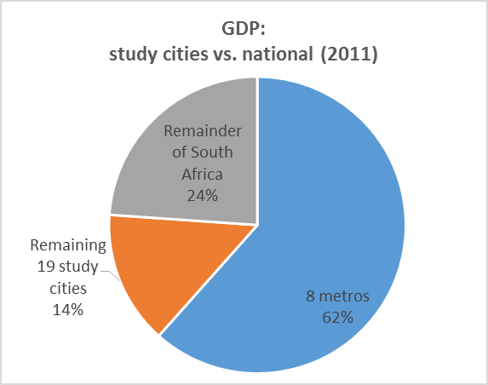
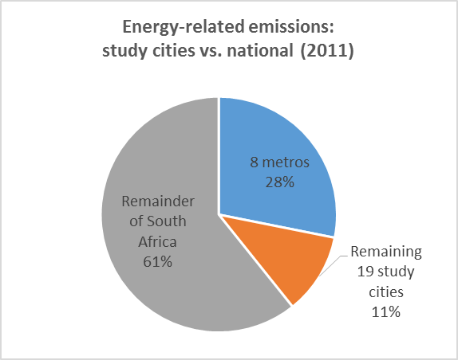
Why Cities?

Slide 4
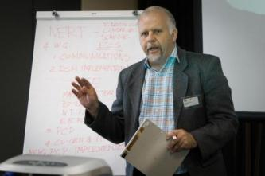
How can municipalities influence energy use?
Building regulations
By-laws, standards, codes
Urban layout
Transport planning (parking requirements, BRT, etc.)
Electricity distribution
Electricity generation (potential)
Electrification / energy service provision (SWHs, etc.)
Embedded renewable energy generation
Procurement policies
Budget allocations
Air Quality control measures
Awareness (energy efficiency behaviour campaigns, forums)
Lead by example (city facilities, rental units, etc.)
Many more…

Slide 5
Exercise: Urban data
What does the data tell you?
What do you think are the priority areas/issues highlighted by the data?
What do you think municipalities can do/influence?

Slide 6
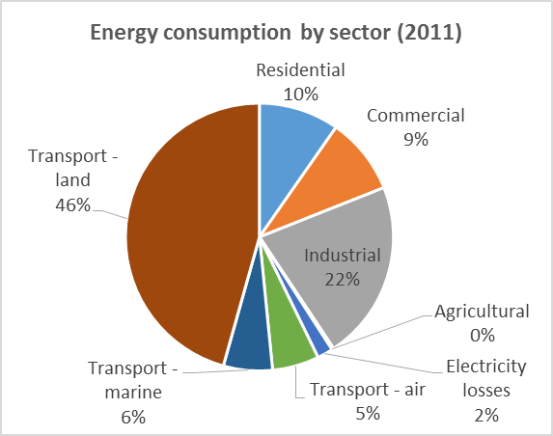
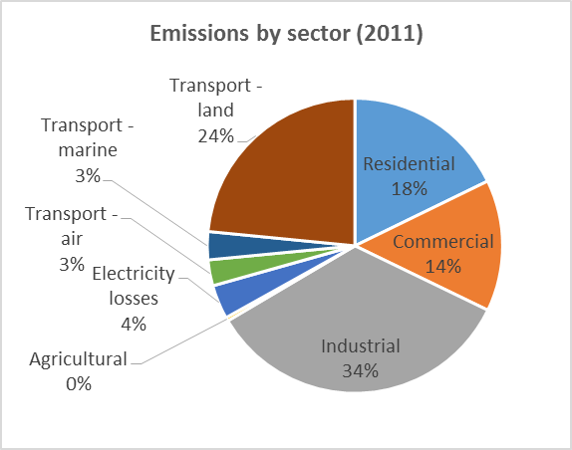
Energy demand and emissions by sector

Slide 7
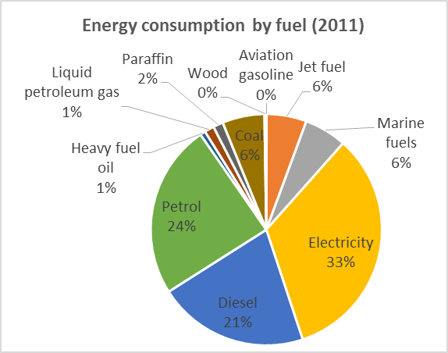
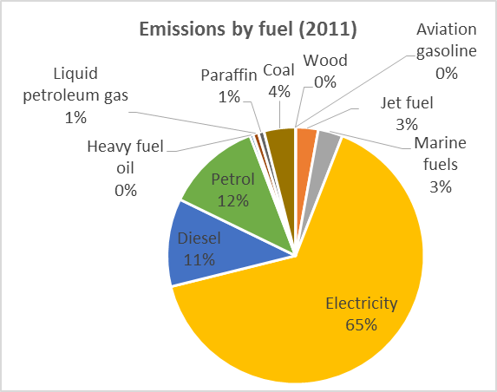
Energy demand and emissions by fuel

Slide 8
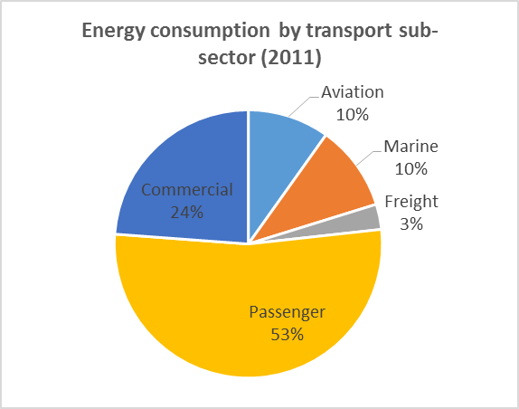
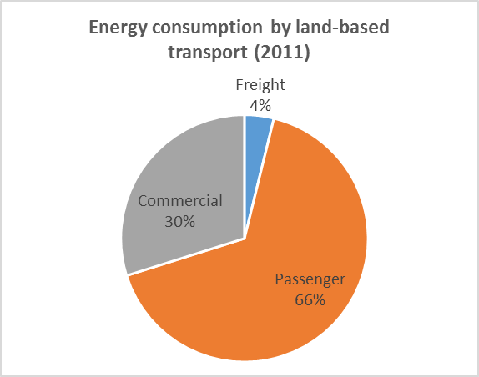
Energy demand in the transport sector

Slide 9
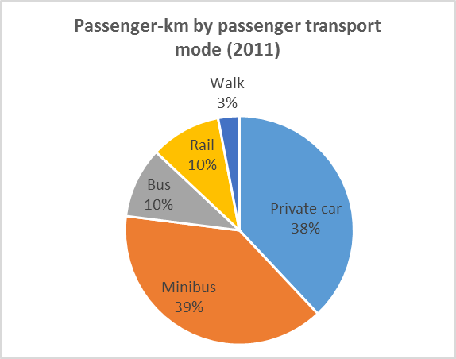
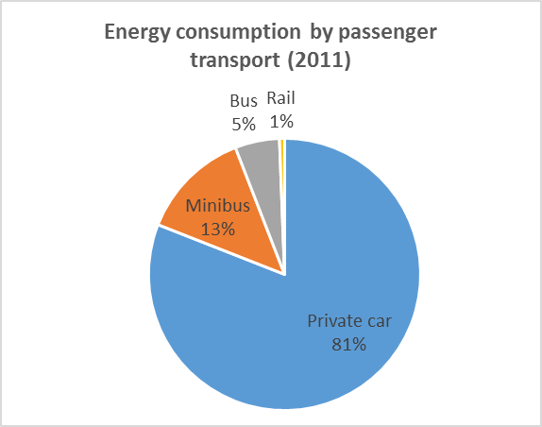
Energy demand vs. passenger-km in the passenger transport sector

Slide 10
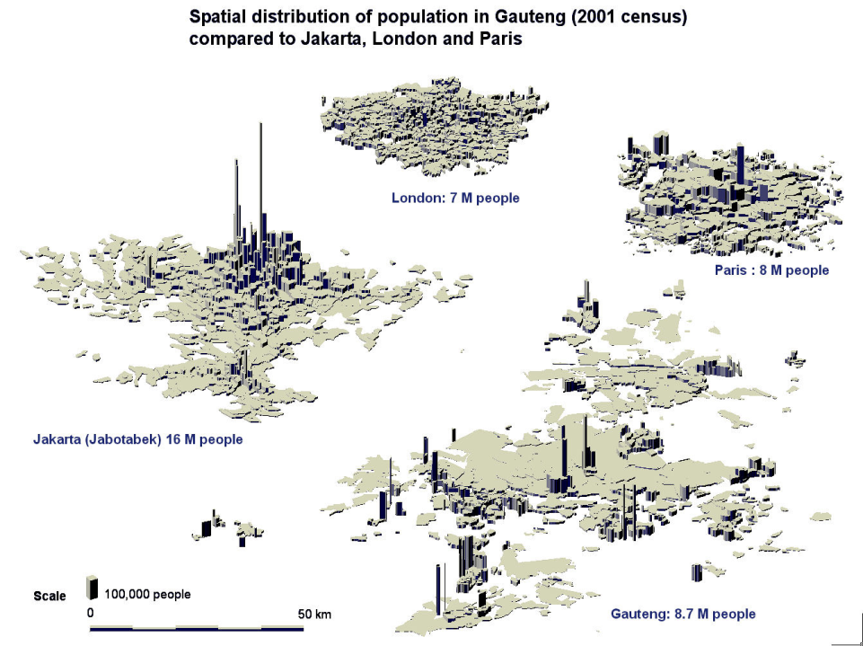

Slide 11
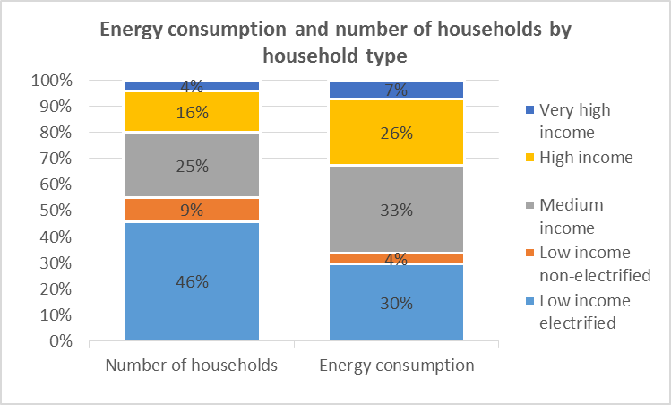
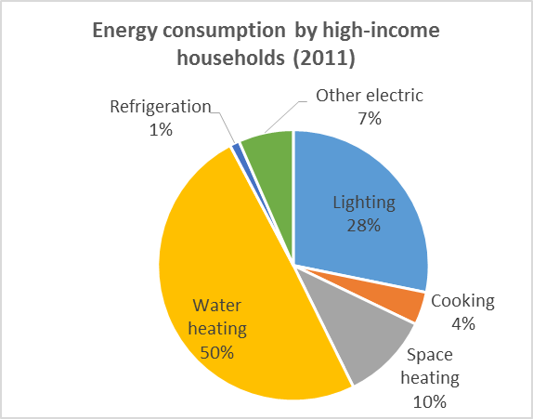
Energy demand in the residential sector

Slide 12
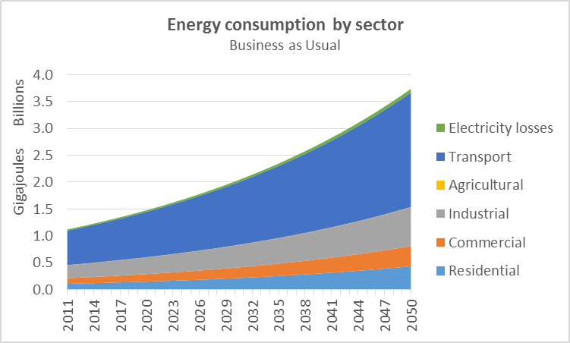
Business as Usual

Slide 13
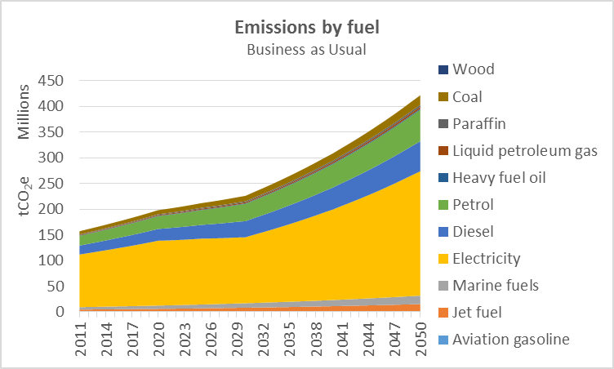
Business as Usual

Slide 14
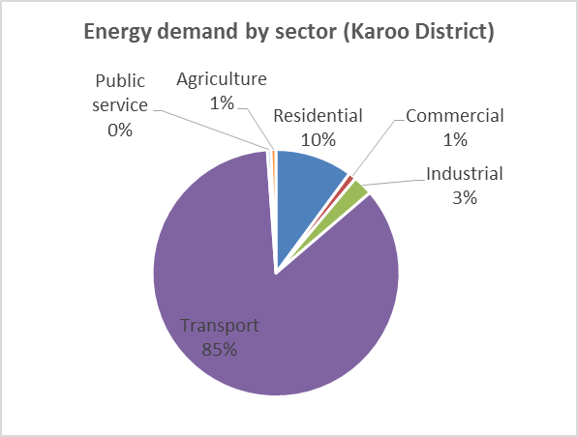
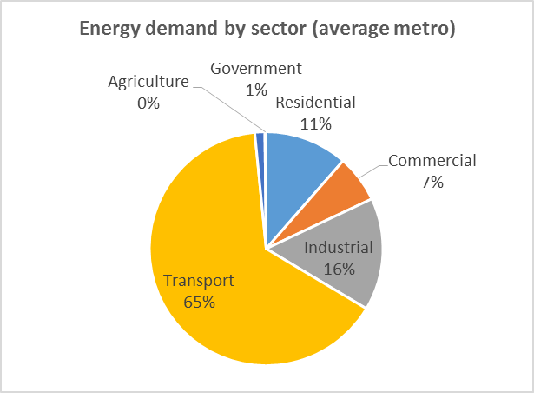
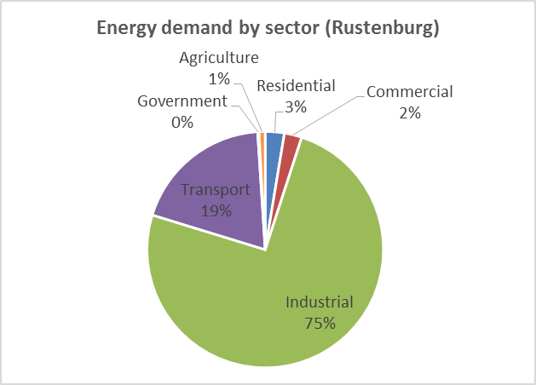
City characteristics

Slide 15
Energy data/modelling influencing policy
State of Energy reports
Energy Strategies
Energy Futures reports

Slide 16
Energy data/modelling influencing policy
Cape Town’s Energy and Climate Change Action Plan

Slide 33
Data sources/challenges
Electricity: municipality and Eskom
Boundaries: municipal vs. Eskom Technical Service Areas
Non-disclosure agreement (NDA)
Liquid fuel: Department of Energy
Boundaries: magisterial vs. municipal
Sector allocation (trade category requires NDA)
Not all data available, e.g. airports, Caltex
Strange figures… (Energy Balance vs. liquid fuel sales)
Coal: municipality (Air Quality), major suppliers and/or users
The Holy Grail…

Slide 34
Free
Flexible
Transparent
Responsive support (online forum, e-mail)
User-friendly
Training materials

Slide 35
Robust outputs
 | Cape Town (LEAP) | Western Cape (Excel)
Business as Usual: average annual energy demand growth until 2040 | 2.8% | 2.5%
Business as Usual: average annual emissions growth until 2040 | 2.5% | 2.3%
Energy Efficiency and Renewable Energy: average annual energy demand growth until 2040 | 1.6% | 1.3%
Energy Efficiency and Renewable Energy: average annual emissions growth until 2040 | 0.7% | 0.9%

Slide 36
Thank you

