Slide 1
Open Science with the Galaxy Project Community
Chris Barnett
@think_za @chrisbarnettster
chris.barnett@uct.ac.za
06 March 2020

Slide 2
Galaxy Project
Galaxy is an open, web-based platform for accessible, reproducible, and transparent computational research.
Accessible: programming experience is not required to easily upload data, run complex tools and workflows, and visualize results.
Reproducible: Galaxy captures information so that you don't have to; any user can repeat and understand a complete computational analysis, from tool parameters to the dependency tree.
Transparent: Users share and publish their histories, workflows, and visualisations via the web.
Community centered: Our inclusive and diverse users (developers, educators, researchers, clinicians, etc.) are empowered to share their findings.
Afgan, E., et al. The Galaxy platform for accessible, reproducible and collaborative biomedical analyses: 2018 update. Nucleic Acids Research 2018;46(W1):W537-W544.

Slide 3
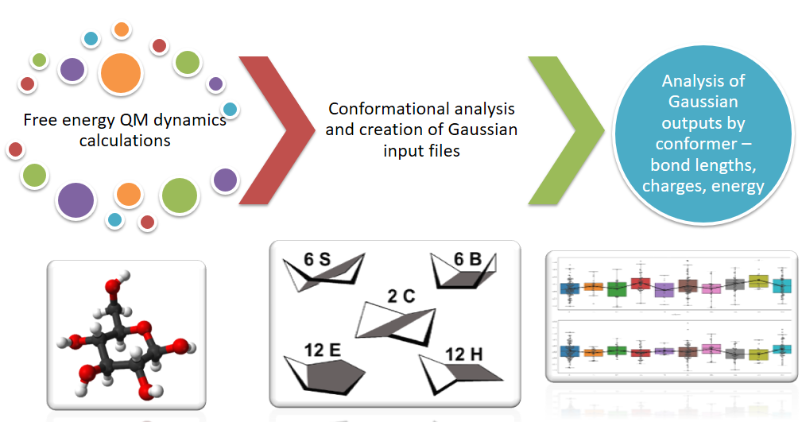
Galaxy for Chemists*
Chemistry data - atoms, connectivity, cartesian data (positions of atoms in space), physical and chemical properties over space and time. Free form or formatted text and several binary data formats
“Computational chemistry excites me,”
Cramer says, “because it lets you look at
‘reality’ all along a pathway, yet can’t be probed experimentally.
I can look at a TS structure and I know that my experimental colleagues are going to have a hell of a time getting any information on it, except indirectly. Having a microscope the whole way – I like that vision.”
S. M. Bachrach, Computational Organic Chemistry, Wiley, 2014.
Notes:
Type of data

Slide 4
Molecular Dynamics and Analysis
Notes:
For example here is a history that was shared with me carrying out MD and analysis.
Link, added to my environment
Full access. I can use tools to carry out further analysis . I can browse the history. I can view some of the data sets (inputs and outputs) . Based on a sequence of tools used I can create a workflow to share with others.

Slide 5
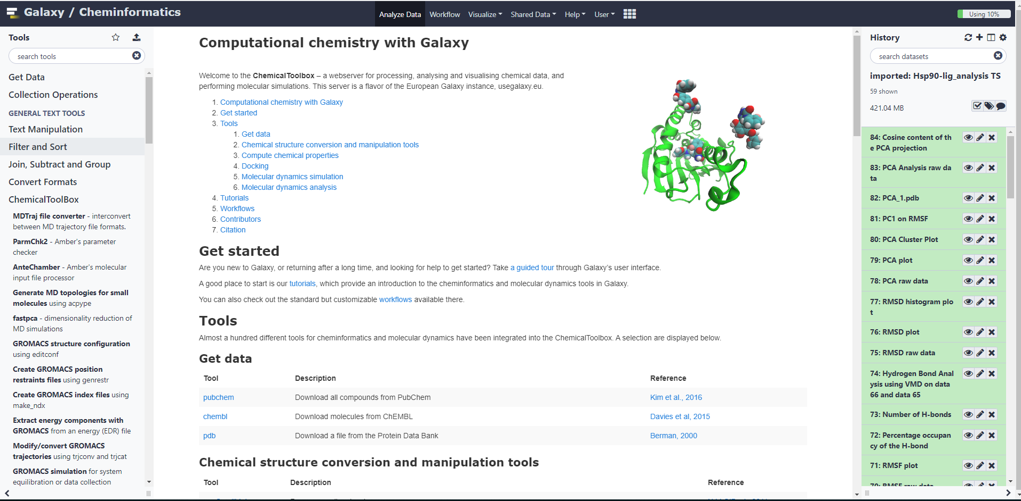
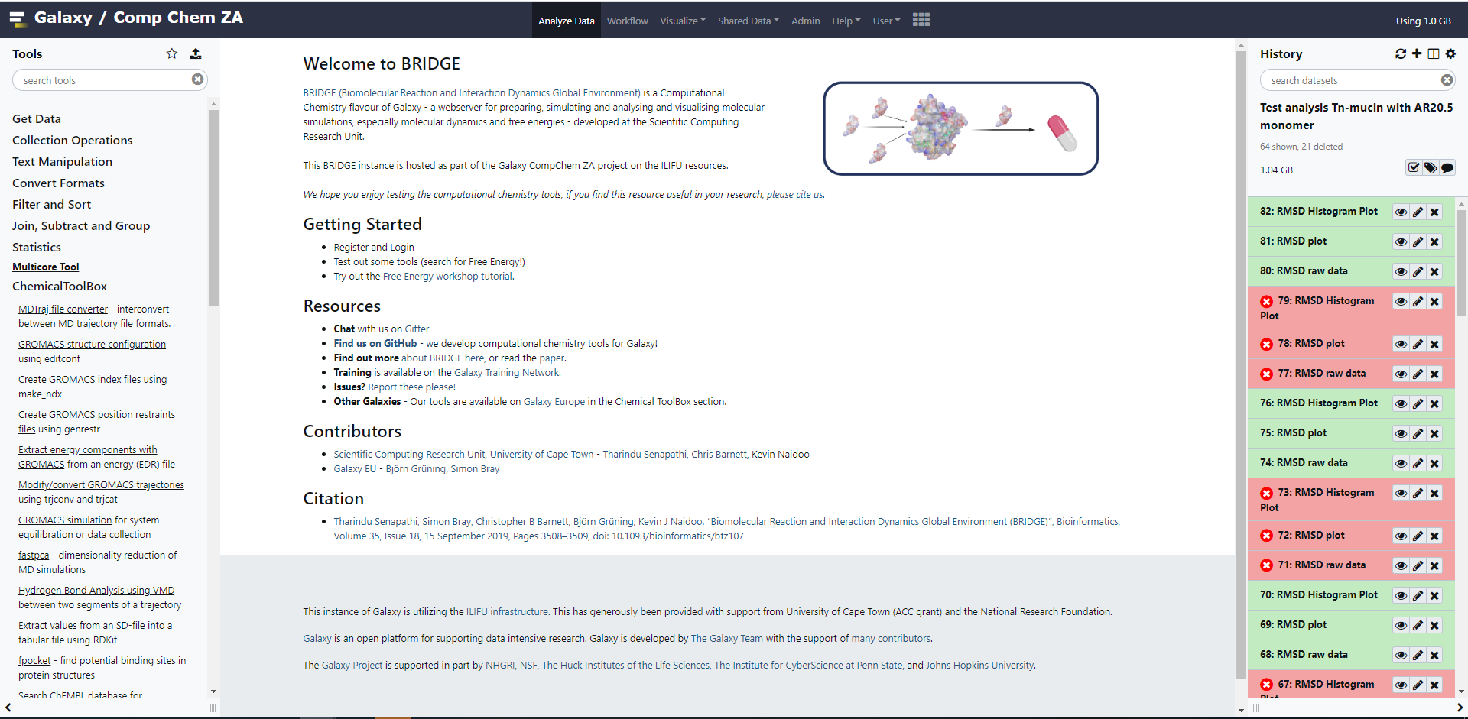
Resources
Training, upskilling & learning
https://training.galaxyproject.org/
Open science – can share curated and functional tools, workflows, visualisations and data.
https://cheminformatics.usegalaxy.eu/
https://galaxy-compchem.ilifu.ac.za/

Slide 6
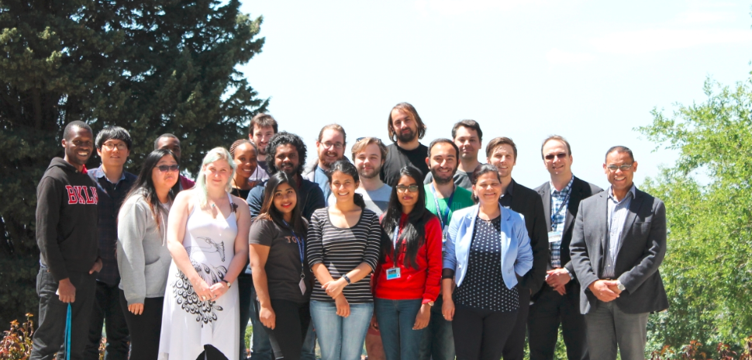
Thank you!
NRF Research Development Grants for Y-Rated Researchers and subsidised by NRF Incentive funding for rated researchers
UCT URC
Galaxy Community Conf Fellowship 2019
U. Freiburg @bgruening @sbray
UCT @tsenapathi Kevin Naidoo

Slide 7
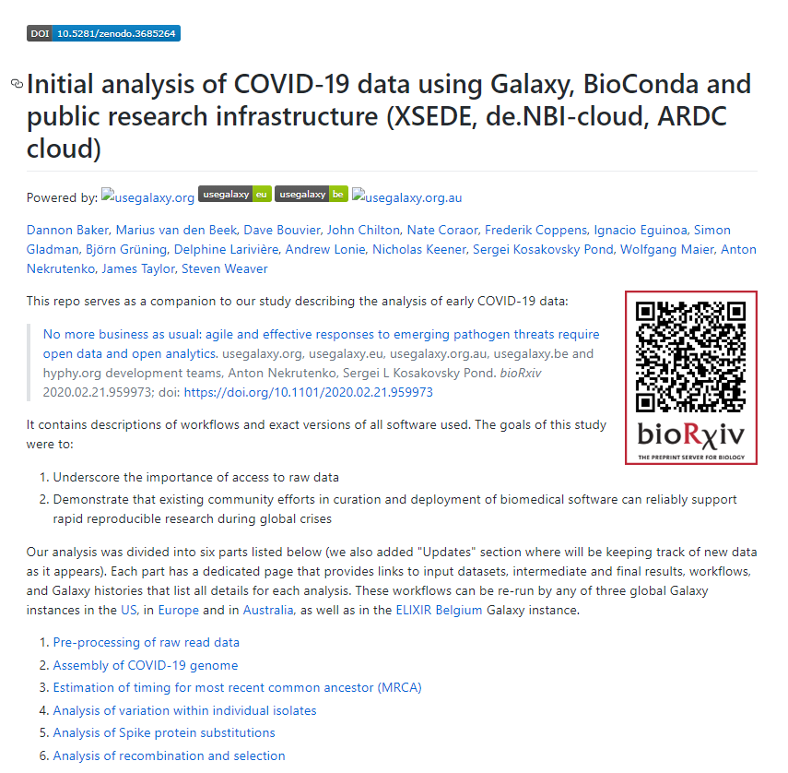
Why exciting – Corona virus Freiburg team
Notes:
Public and Citizen Science.
Exciting use case that fits the open science theme. In fact the corona virus example from the Galaxy EU team is pretty interesting. Have this as a backup.

