Slide 1
OPEN DATA PROJECT
January 2020

Slide 2
Content
The Problem
Solution
Outcome
Looking ahead

Slide 3
The problem

Slide 4
The problem
The City generates significant amounts of data/information
This information is often hidden from view in line department archives or is difficult to access.
Various organisational data access policies and procedures impede public access to information.
The data is not in user friendly format
The data is old or out of date
The data is not always in machine readable format

Slide 5
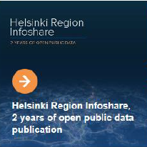
Trend towards open data
A number of city governments including New York, London and Helsinki have embraced the open data approach
Innovators and entrepreneurs are using these large data sets to design new kinds of products, enhance their competitiveness, build social capital and engage in civic life.

Slide 6
Solution
Policy
Portal
Institutional arrangements

Slide 7
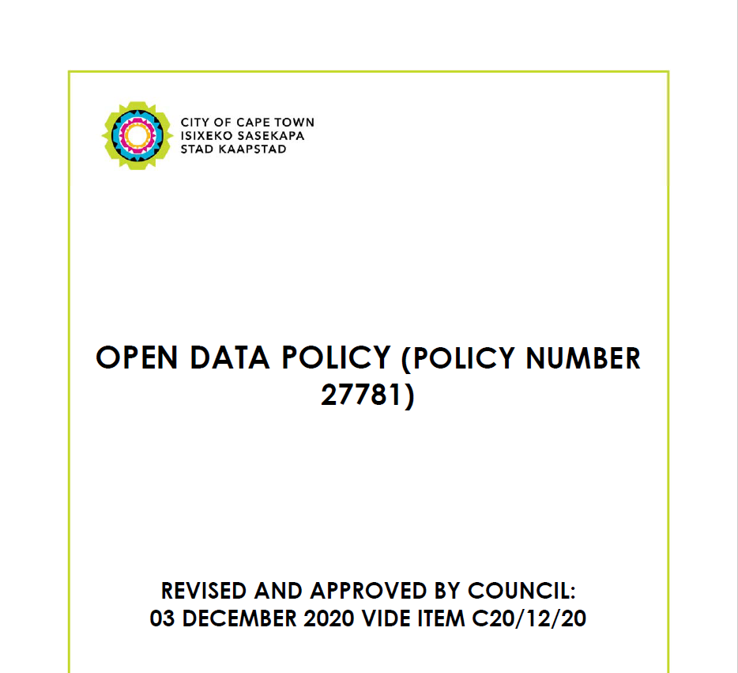
Open Data Policy
Open Data Policy approved by Council on 25 September 2014
2nd Review of Policy initiated October 2019 and revised Policy approved December 2020

Slide 8
Development of the Open Data Portal
ICT Enabled Open Data Portal

Slide 9
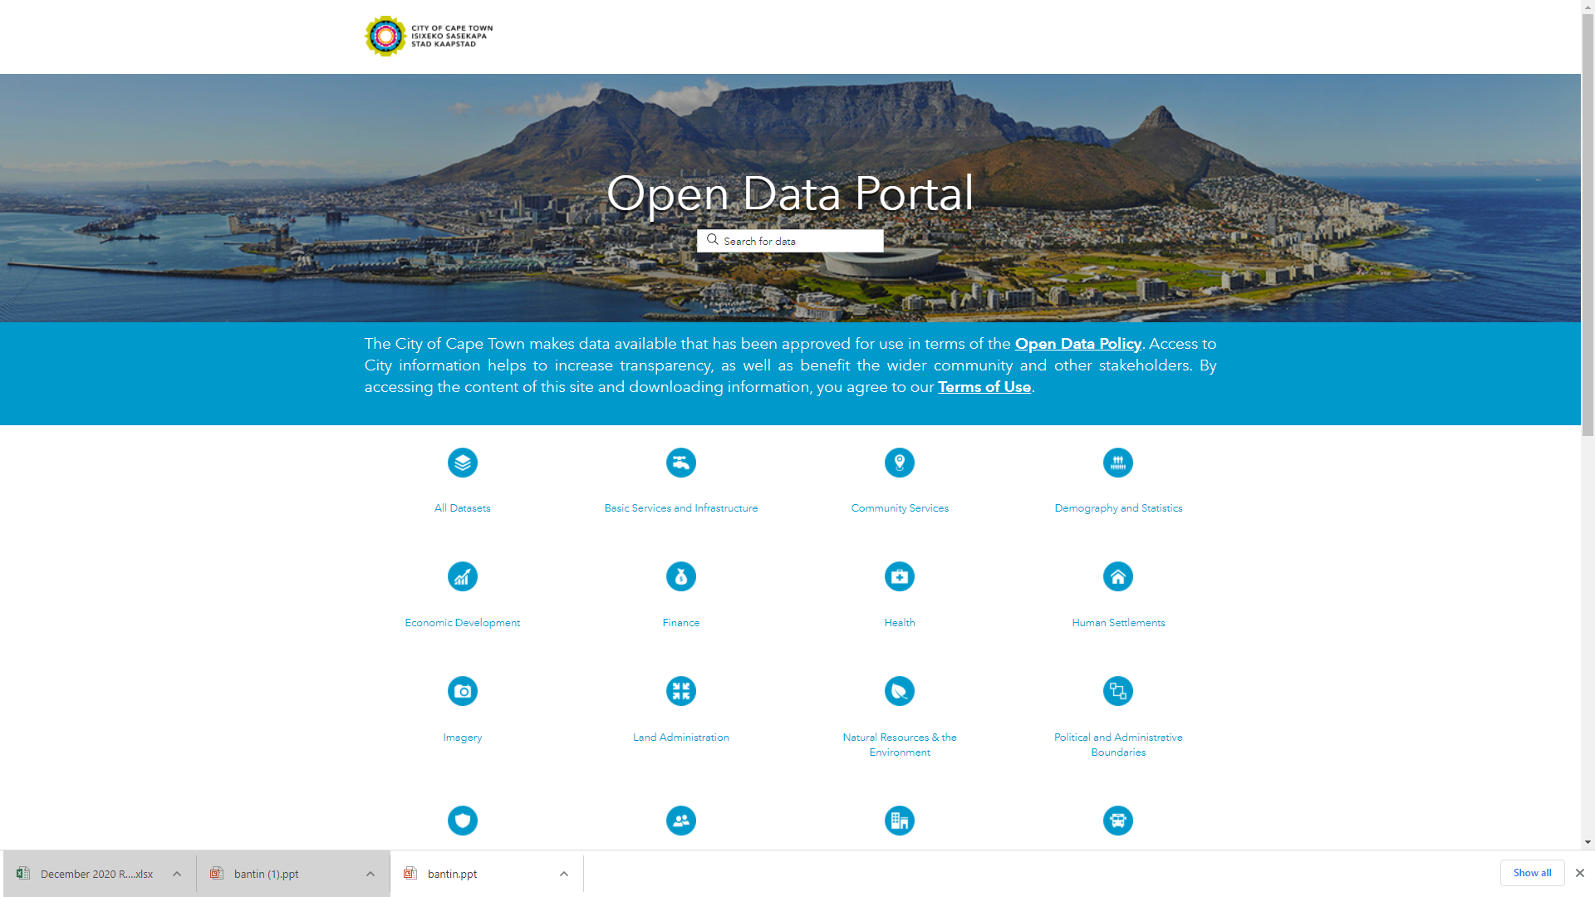
DEMO - https://odp-cctegis.opendata.arcgis.com/

Slide 10
Outcomes

Slide 11
Bringing City data into the light
The Open Data Portal provides residents with access to some of the City’s huge datasets, covering everything from mapping of the urban edge through the location of recreational facilities and fire stations to tenders awarded. And that was just the start …
Open Data Portal was Launched on 27 January 2015
Notes:
outcomes

Slide 12
Portal Content
Open Data Suggestions
Approximately 400 dataset suggestions
numerous feedback messages
Open Data Content
156 datasets published containing more than 2000 files
Approx. 150 000 downloads since Feb 2015

Slide 13
Usage of the portal
Data requested where users have indicated they intend to develop applications including in the areas of “Electricity Loadshedding” and “Air quality monitoring “.
Some of the City’s data are being used in completed applications/tools
GITHUB - Water Watch Cape Town - a page where people can check on the dam levels (https://dinebennett.github.io/water-watch)
Fire Incidence data - IBM scientists have developed a cognitive dashboard. This can assess fire incidence risk and severity to help officials raise public awareness and prepare for emergency response.”
Open data portal address data feeds into https://openaddresses.io/ which is increasingly being used by a number of Geo lookup services (Mapbox, Mapzen etc)
Budget visualisation that was done by Ndifuna Ukwasi http://capetownbudgetproject.org.za/

Slide 14
Usage of the portal
Researchers have requested
Data identifying the benefits of public access centres, using SmartCape as the case study and the Harare Library as the specific site
Air quality data for use in experiments relating to visualising and identifying trends within the data.
Electricity voltage dips data for conducting some research about the reliability of electricity supply across South Africa's metropolitan municipalities and the implications on the cost of doing business.
Certain departments use portal to disseminate data that are often requested from the City - to environmental professionals in relation to bio-diversity data and land survey professionals in relation to land survey data

Slide 15
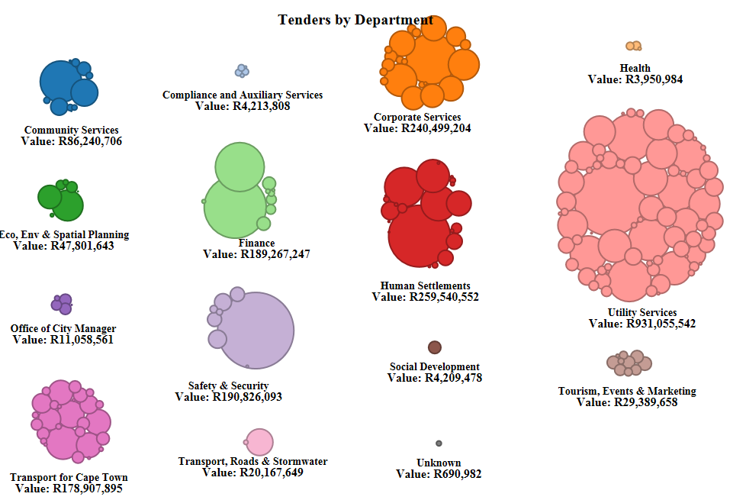
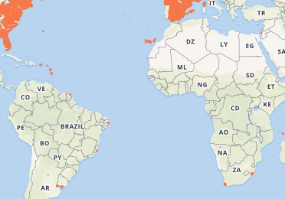
Using the City’s Open Data
Cape Town street address data made available at https://openaddresses.io/#

Slide 16
Open Data User Profile (based on available information)
Researchers
Small businesses
Professional consultancies.
Non-governmental organisations
Entrepreneurs
Citizens

Slide 17
Reasons supplied by users for requesting datasets:
Housing development
For research and analysis purposes
Public interest
Water Awareness
Surveying
Planning
Data Science

Slide 18
Top 10 Popular Datasets
No. | Dataset Name | 2018 | 2019 | 2020 | 2021
1 | Tender awards | 7000 | 10769 | 13493 | 17096
2 | Water consumption | 3577 | 10854 | 13453 | 14521
3 | Aerial photography | 1755 | 3222 | 4607 | 5388
4 | Parking zoning | 1671 | 3000 | 4402 | 5294
5 | Town survey marks | 1639 | 2497 | 3183 | 3590
6 | Dam levels | 977 | 2182 | 2884 | 3138
7 | Building footprints | 1201 | 1985 | 2659 | 3109
8 | Requests for quotations awarded | 635 | 1355 | 2432 | 2908
9 | Air quality | 1343 | 2037 | 2639 | 2873
10 | Land parcels | 1360 | 2004 | 2499 | 2852

Slide 19
Open Data: The Portal and the Ecosystem

Slide 20
Open Data Engagements
Annual engagement with the University of Manchester
Development Action Group
Policy Roundtable Data Session on Informal Settlements
Round table discussion on data University of the Western Cape (COLAB)

Slide 21
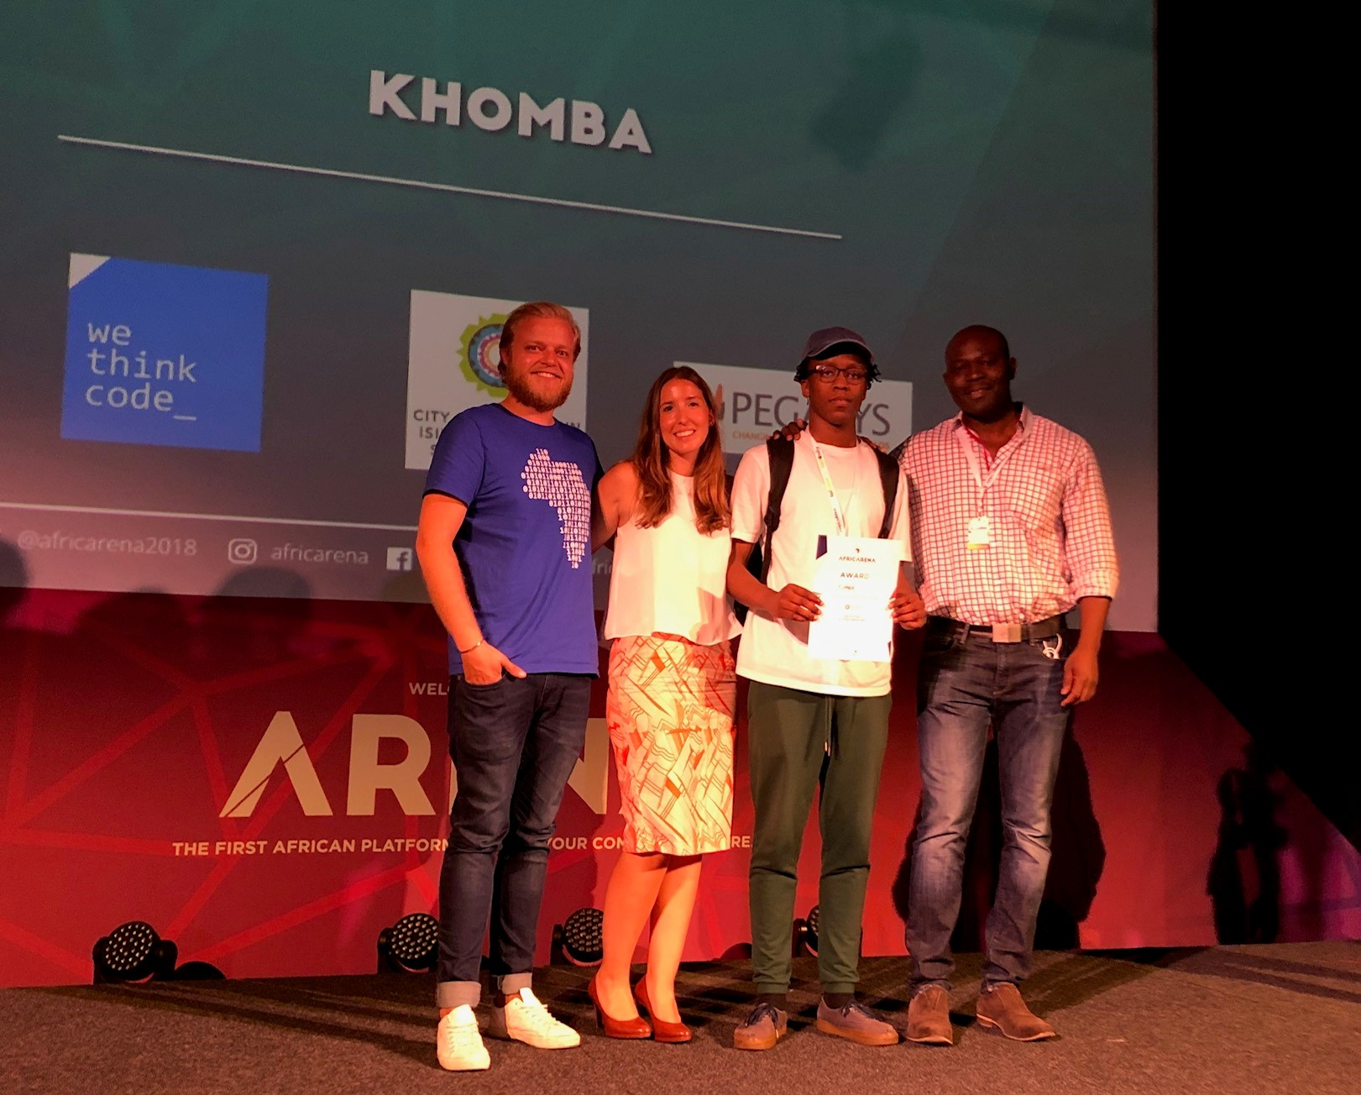
Public Transport Hackathon November 2018
Collaboration between COCT, WeThinkCode, AfricArena, GEEKULCHA, Pegasus
Held on 15 & 16 Nov 2018 at the Century City Conference Centre
Problem: There is a lack of predictability regarding minibus taxi and train schedules in Cape Town, hampering passenger mobility, impacting socio-economic development, and reducing passenger safety.
Challenge: To give passengers visibility of train and taxi locations, the teams need to develop a cell phone-based App that improves predictability in travel time in an unscheduled environment.
5 teams comprising 30 people, 3 speakers, 3 mentors and 4 judges
First: Khomba developed a peer to peer multilingual app with a chat room, that uses commuter info for commuter travel
The first-place team won R10 000 (Pegasus) and a chance to pitch their app to the international investors at the AfricArena

Slide 22
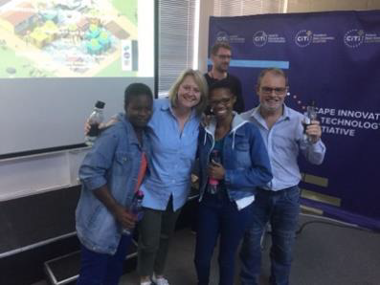
Open Data Water Hackathon April 2018
Cape Town Water Saving Design Sprint
Woodstock Bandwidth Barn from 14 – 15 April 2018
Teams had to come up with ideas on how to use technology to encourage behavioural change regarding water-saving
Ten teams comprising 61 people, 4 speakers, 4 mentors & 3 judges
FIRST – “Litre Lights” - Instant & visual feedback of water usage by installing Loo Lights, Ambient Tiles and Shower Lights which are linked to an easy-to-install litre measuring system. This integrates with an online dashboard and a phone app.
The first-place team were awarded a month of free office space at the Shipyard co-working space of the Woodstock Bandwidth

Slide 23
Open Data Ecosystem – Example - opendatamonitor.eu

Slide 24
Looking ahead

Slide 25
Open Data Focus Areas
Enhancement of Open Data Portal (automation of data updates)
Linking to bigger datasets
Building Data sharing culture
Dealing with data that could be construed as private
Promoting Usage of the Portal (building an open data ecosystem)
Processing outstanding data suggestions

Slide 26
Notes:
Changes to slides – 31,30,24-27, 21,18,19, 2
Open Data Ecosystem - slide
Odln broad lessons – slide
M&E framework – key indicators
ADI -

