Slide 1
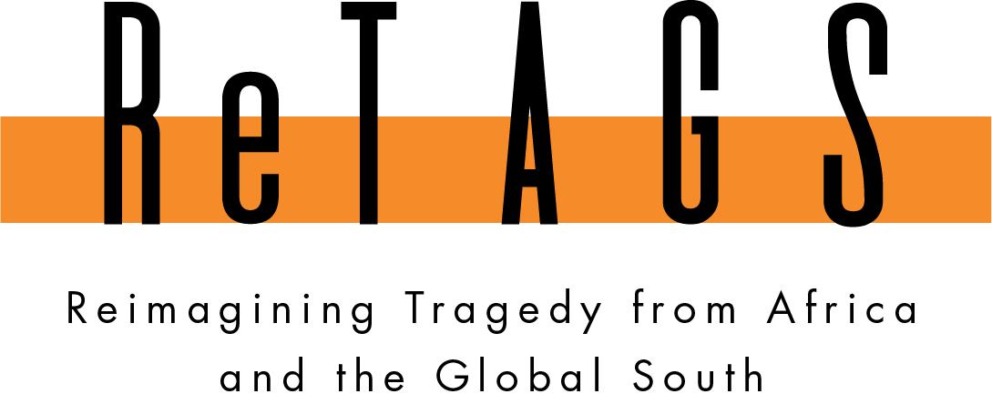
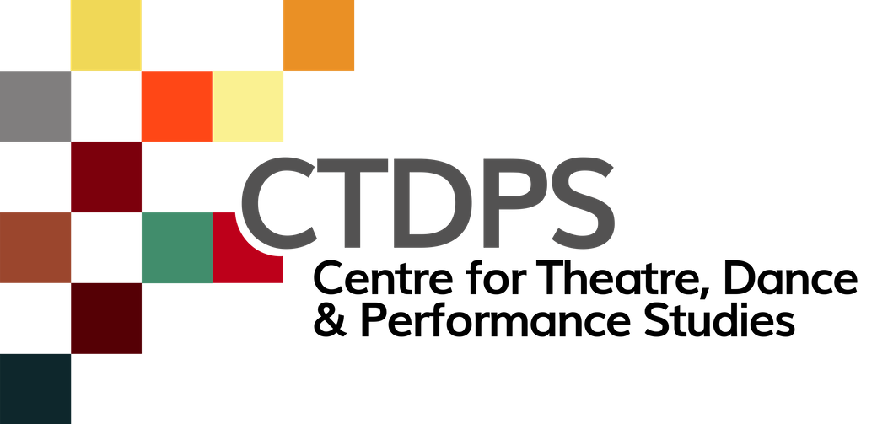
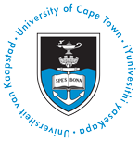
Developing
Non-text-based
Living Archives
UCT open data day
05 march 2021
Presented by Jayne Batzofin

Slide 3
OBJECTIVES OF THE RESEARCH
The development and staging of four Practice as Research based theatre productions.
Conducting field research interviews discussing tragedy on and off the stage in Africa.
Collecting production information of staged African adapted Tragedies.
Decolonizing Western theatre pedagogies by sharing the rehearsal processes of African artists.
Investigating the complex challenges of our global postcolonial present and looking towards our possible futures.

Slide 4
Acknowledging that archives are never neutral and reflect colonial epistemologies, how can we move towards a postcolonial archive and initiate “an ‘epistemic disobedience’ in order to generate decolonial freedom.”
Walter Mignolo, 2011

Slide 5
NON-TEXT-BASED
DATA
LIVING
ARCHIVE

Slide 6
OBJECTIVES OF THE LIVING ARCHIVE
Shedding the concept that archives are dormant, disembodied narratives of a dominant culture.
Investigating how digital archives for cultural heritage can become social resources, facilitate social change, create cultural awareness and collective collaboration.

Slide 7
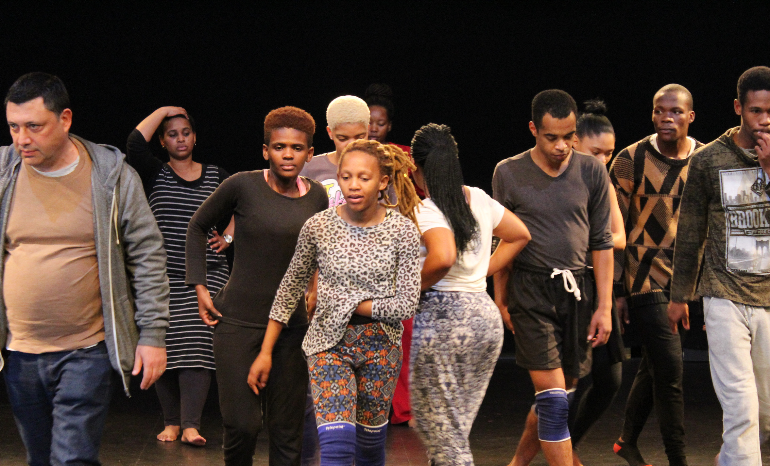
IKRELE LECHIZA
2021
Antigone (not quite/quiet)
2019

Slide 9
Showcasing
the Digital Archive

Slide 10
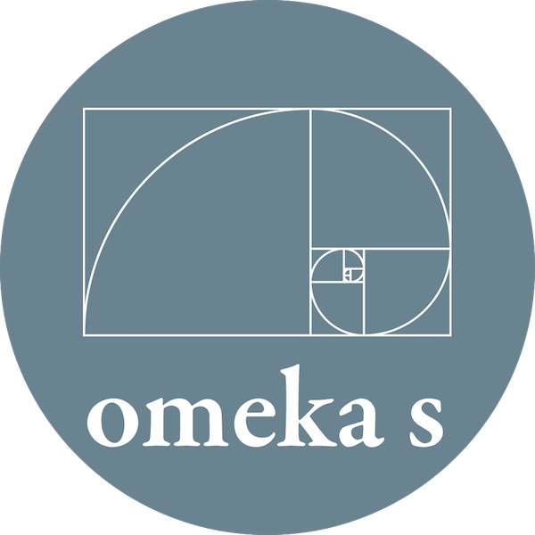
OMEKA S
Exhibition tool for the GLAM (Galleries, Libraries, Archives and Museums) sector to showcase Digital Collections.
"Omeka S is a next-generation web publishing platform for institutions interested in connecting digital cultural heritage collections with other resources online."

Slide 12
"The live performer in this context is not the person on stage, but the archive user who controls the keyboard and the mouse. The actions of their searching and viewing, collecting and narrating are their modes of performance. […] these practices enliven the material of the archive through actions of use.”
Laurene Vaughan, 2015: 56

Slide 13
CONTACT
Jayne Batzofin
Digital Archivist
jayne.batzofin@uct.ac.za

Slide 14
REFERENCES
Carlin, D and Vaughan, L. 2015. Performing Digital: Multiple Perspectives on a Living Archive. Ashgate Publishing.
Hall, S. 2001. Constituting an archive, Third Text 15:54: 89–92.
Mignolo, W. D. 2011. The darker side of western modernity: global futures, decolonial options. Durham, NC: Duke University Press.
Malmö University. Living Archives: (Archiving a) Research Project. https://livingarchives.mah.se/about/. accessed 2021-03-03.
.

