Slide 1
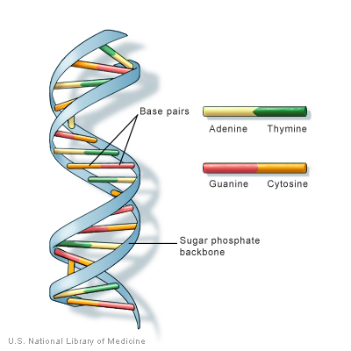

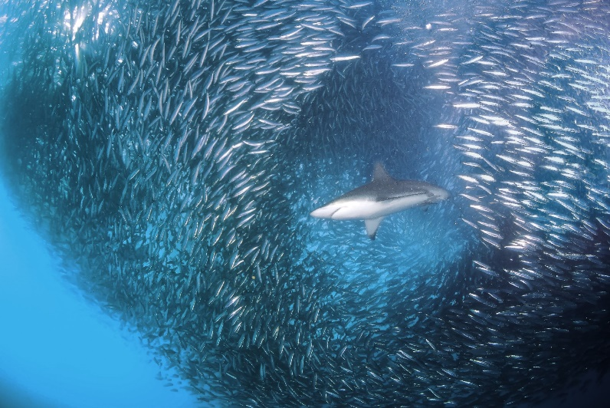
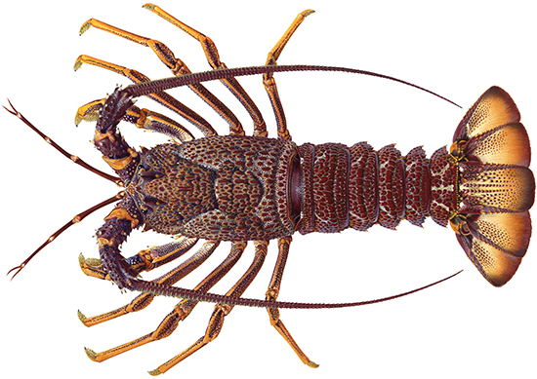
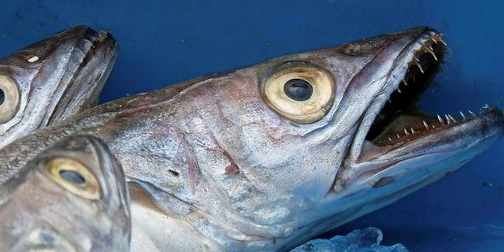
INTERNATIONAL REVIEW PANEL REPORT FOR THE 2019
INTERNATIONAL FISHERIES STOCK ASSESSMENT WORKSHOP
NON TECHNICAL SUMMARY

Slide 2



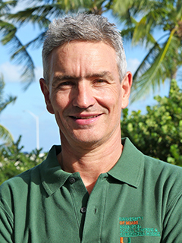
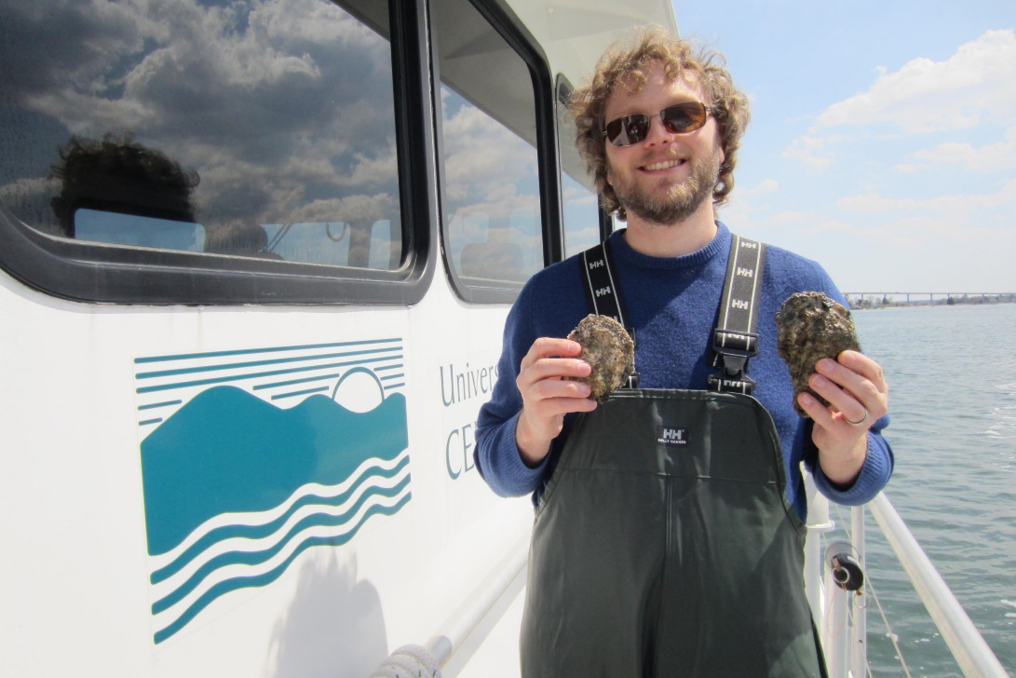
The Panel
David Die, U Miami, USA
André Punt, UW, USA
Ralph Tiedemann, U Potsdam, Germany
Robin Waples, NMFS, USA
Michael Wilberg, UMCES, USA
Expertise in quantitative fishery science, management procedure evaluation, stock assessment, genetics, and statistical analysis of data

Slide 3
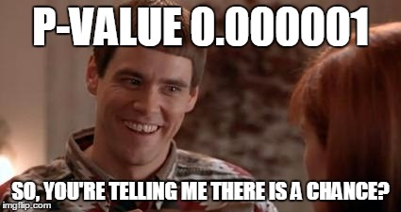
The 2019 IWS Panel
Topics
  South African hakes
  Sardines
  West Coast Rock Lobster
  Closure experiments for Penguins

Slide 4
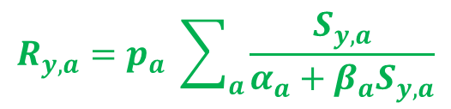
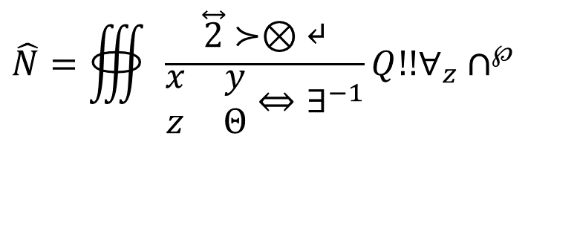
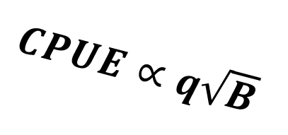
$$R_{y,a}=p_{a} \sum_{a}{\frac{S_{y, a}}{α_{a}+β_{a}S_{y,a}}}$$
Latent covariates
ddRAD SNPs
Pseudoreplication
$$\hat{N}=∰{\frac{\overset{⃡}{2}≻⊗↵}{\begin{matrix}x & y \\ z & Θ\end{matrix}⇔∃^{−1}}Q!!∀_{z}∩^{℘}}$$
Bayesian
filtering
Inverted Hessian
Effect size
$CPUE∝q\sqrt{B}$
F_{ST}
Pool-seq

Slide 5
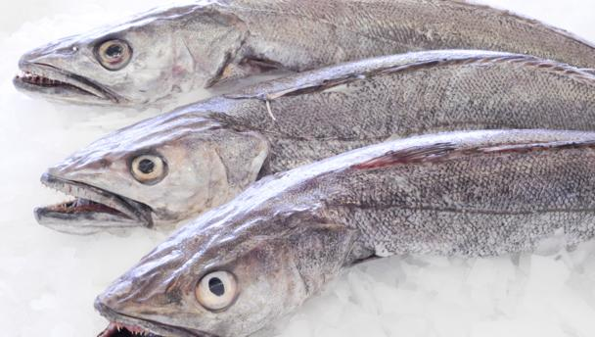
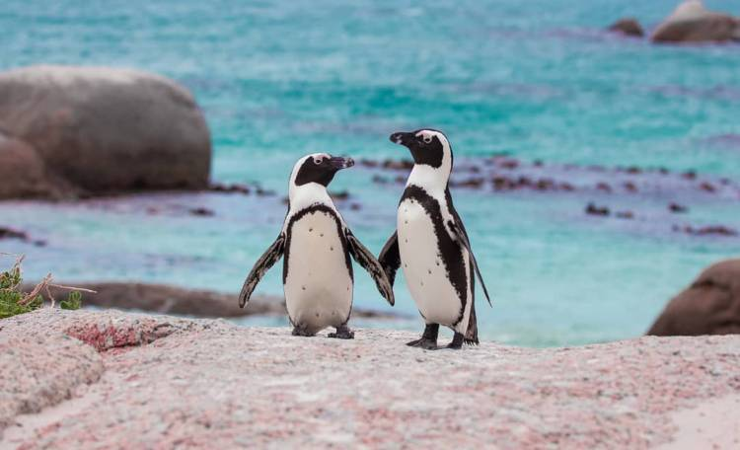
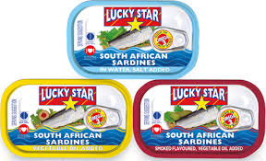
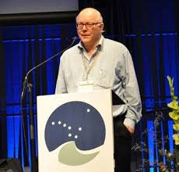
With Special Guest Stars

Slide 6
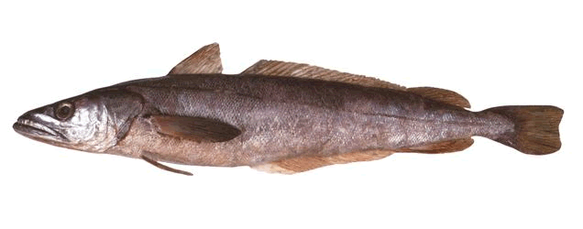
Focus of the review
Hake Stock Structure
  Does the new data change the view of stock structure for M. paradoxus?
Hake OMP Model Structure
  Do the scenarios being considered sufficiently cover uncertainty and correspond to the data?

Slide 7
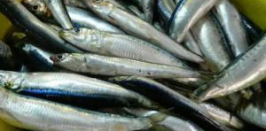
Focus of the review
Sardine
  How to compute estimates from the acoustic survey when survey length-frequencies appear unrepresentative?
  What is the best way to conduct short-term forecasts for TAC recommendations?
Penguin
  Have the analyses using the penguin closure experiment data been sufficiently tested to be considered reliable?

Slide 8
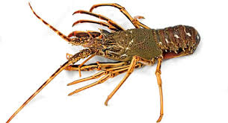
Focus of the review
West Coast Rock Lobster
Estimation of poaching removals
  Have the recommendations from the 2018 review been implemented appropriately?
Projection methodology
  Are the assumptions underlying the current way projections are undertaken appropriate?

Slide 9
Overall Comments
The Panel was impressed with the quality of information presented. Well done all!!
The Panel thanked the participants for their hard work preparing and presenting the workshop papers, for the extra analyses undertaken during the Workshop, and for the informative input provided during discussions.

Slide 10
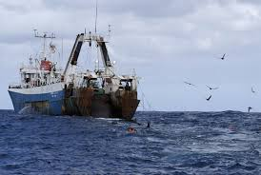
Hakes
Stock structure
  The Panel considered the genetics and other biological data and made recommendations about stock structure

Slide 11
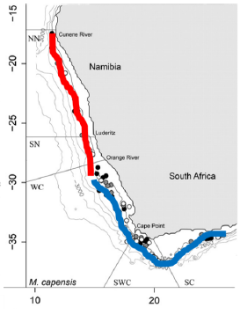
Hake stock structure (M. capensis)
Henriques et al. 2019
Henriques et al. 2016

Slide 12
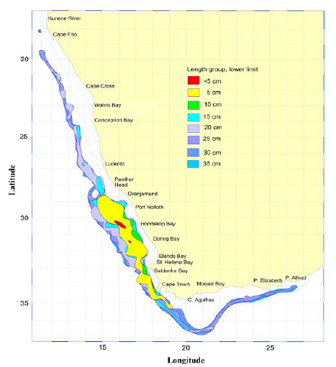
M. paradoxus stock structure (genetic and other biological data)
M. paradoxus (size distribution)

Slide 13
Hakes
OMP model structure
  One model was suggested for M. capensis - 2 stocks (South Africa and Namibia)
  Several models were developed (conceptually) to represent M. paradoxus stock structure for OMP testing

Slide 14
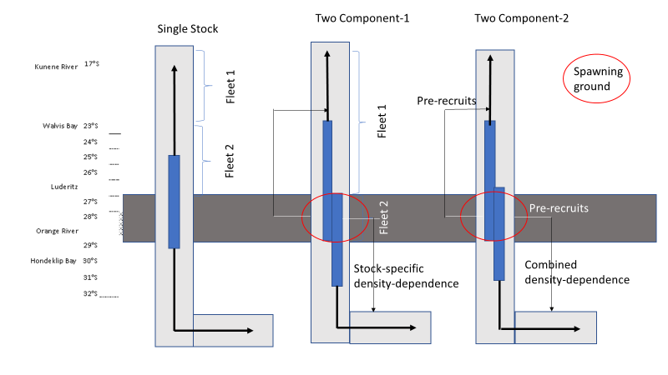
Hake stock structure hypothesis

Slide 15
Area closure experiments for penguins
Some progress was made on understanding the potential effects of statistical modeling choices
It is important to understand potential for bias caused by modelling decisions
  The Panel recommended focusing future discussion on the forecasted effects of closures on penguin population dynamics rather than focusing on estimation methods

Slide 16
Sardine: questions, and recommendations (I)
Are survey length data representative?
  It’s difficult to tell – continue to use the data
Recruitment for short-term projections
  Use recruitment from recent years, be careful about use of estimates from years that are poorly estimated (Nov. 2017)

Slide 17
Sardine: questions, and recommendations (I)
The population appears to be at very low biomass
  In other parts of the world, management becomes increasingly more cautious as populations decline
Long-term projections and rebuilding
  Projections of the sardine biomass should show important metrics like catches, the proportion of population growth allocated to resource recovery, and the probability of not achieving an interim rebuilding abundance

Slide 18
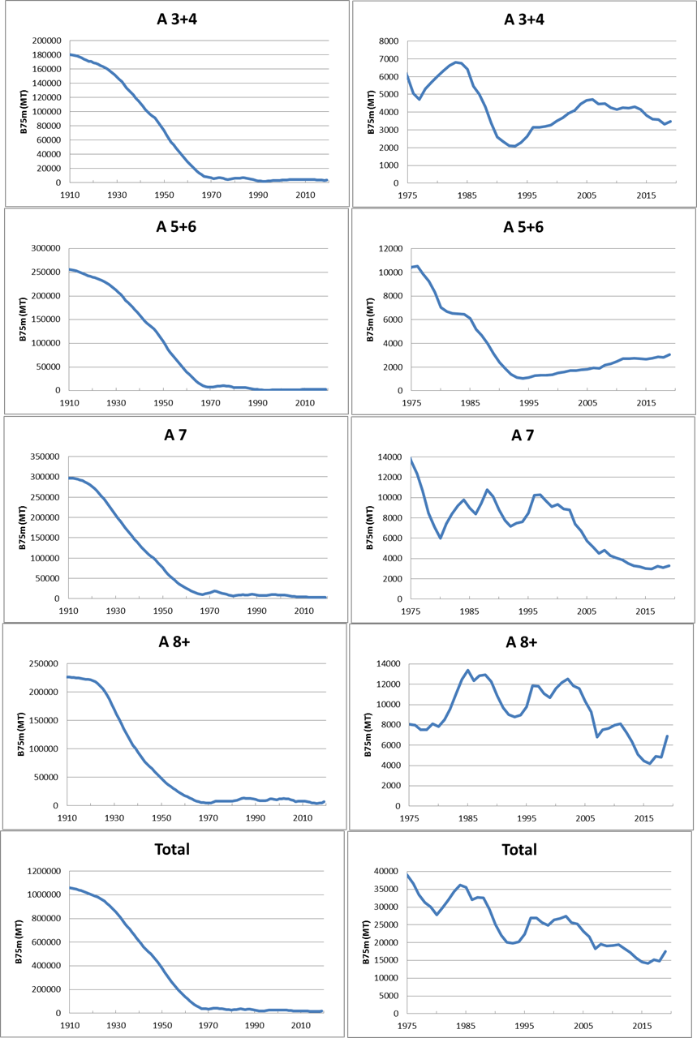
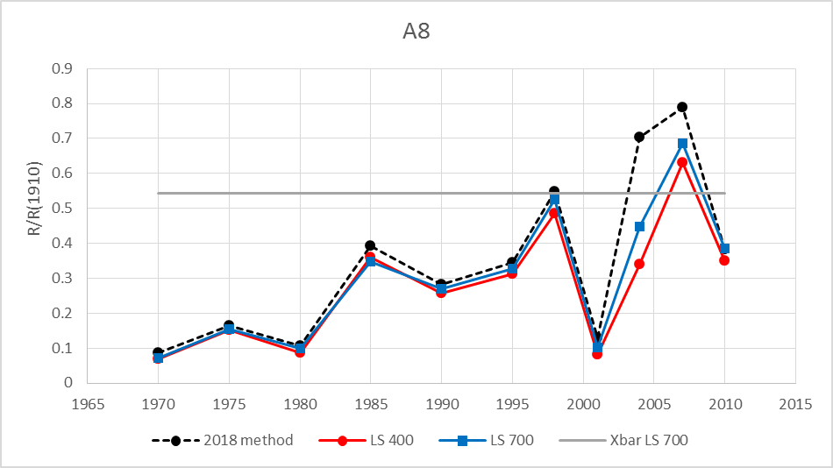
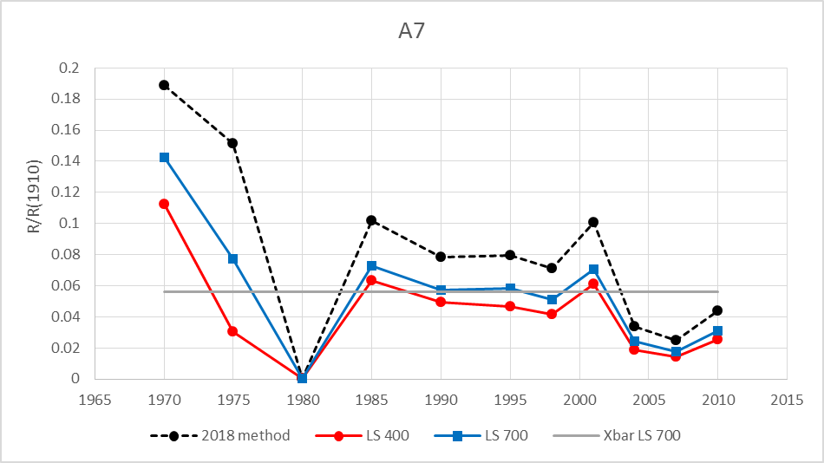
Rock lobster
Biomass of legal Lobster >75mm CL)
Severely depleted stock
Recruitment (number of small lobsters entering the population) is low in many areas but high in others and it is not declining in all areas
The OMP has been abandoned and TAC has to be calculated with a new interim procedure.

Slide 19
Estimation of poaching
The 2018 Panel recommendation have been appropriately addressed.
The 2019 Panel recommends that a new survey approach to estimate illegal activities be considered as an additional alternative to the current methods used to estimate poaching.

Slide 20
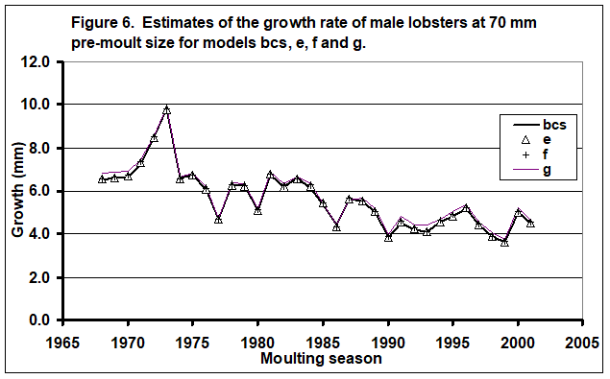
Estimation of population
Information on changes in growth rates through time is unique in the world
It represents a real management challenge because it implies that the productivity of the stock has been declining
The reasons for this decline are unclear, but having information on this decline may help SA adapt to it, so tagging studies must continue
Panel recommended:
Some changes to assessment model to improve estimates of recruitment and catch and biomass predictions needed to set TAC
Proportion of the resource growth assigned to recovery should be higher for more depleted populations.

Slide 21
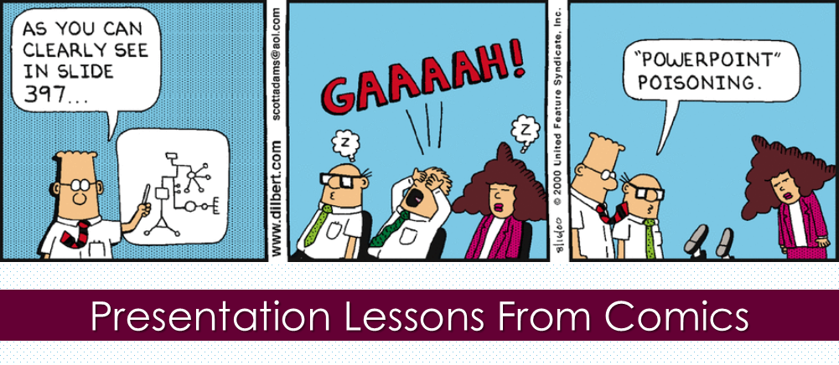
Lets move from Powerpoint Poisoning to questions

