Slide 1
Spatial Heritage Documentation
Zamani Project
Structure of presentation
History of the Zamani Project
Fieldwork and Data Processing
Metadata, file management, data management
Examples of Zamani Data
Short Video
Q&A

Slide 2
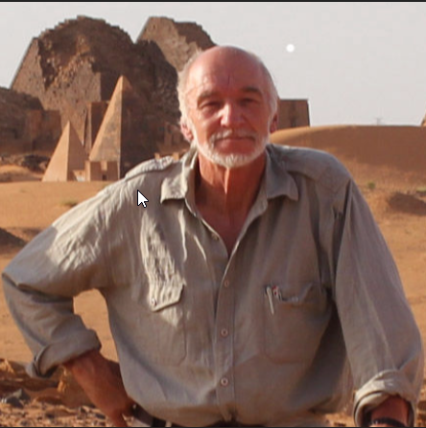
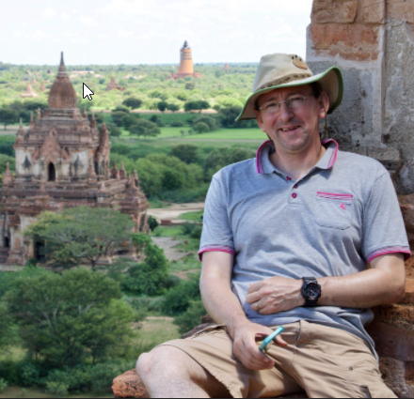
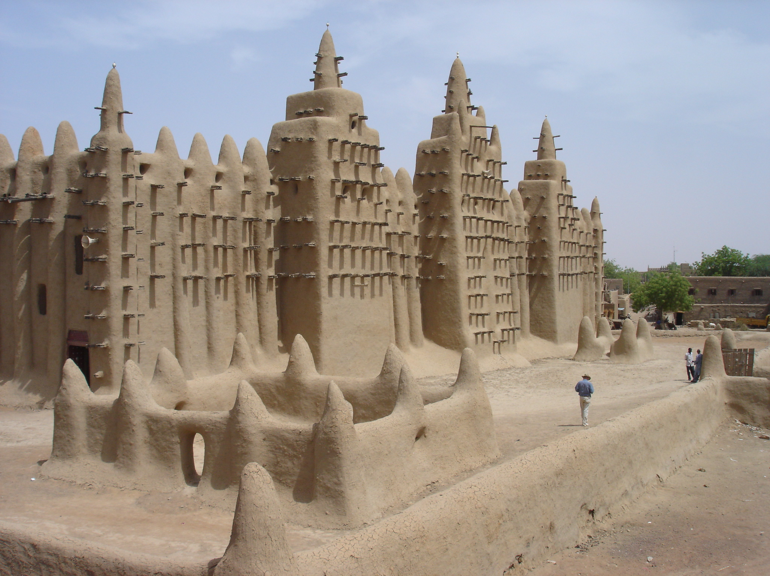
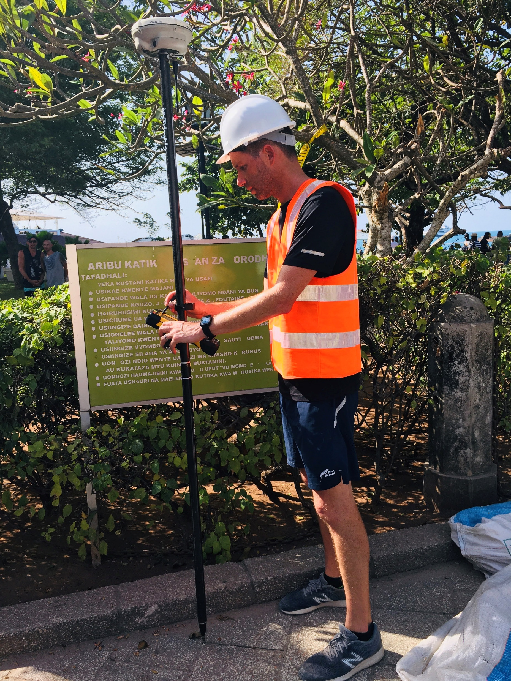
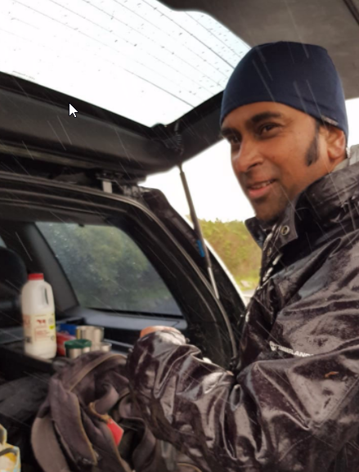
The Zamani Team
Prof. Heinz Ruther (Principal Investigator)
Ralph Schroeder
Bruce McDonald
Roshan Bhurtha
Based in the Geomatics Division
University of Cape Town
South Africa

Slide 3
History of the Zamani Project
The Zamani Project started in 2004 by Prof. Heinz Ruther
Grant from the Mellon Foundation until 2012
Since 2013, Zamani African Cultural Heritage Sites Trust

Slide 4
African Cultural Heritage Sites and Landscapes Database
Interactive Integrated Spatial Information System
2D- Data
3D - Data
Image Data
Contextual Data
Non-Spatial data
Historical background
Historical background
Scientific papers
Site related Documents
Old maps and diagrams
Photographs
Excavation reports
Conservation reports
Environmental Information
Site management
Scientific papers
Site related Documents
Geographic Information Systems
Point clouds
Photography with calibrated cameras
Multi Resolution
3D-Models
Elevations,
sections & plans
Full dome panoramas in pano-tours
3D Visualisations
Contextual Photography
Location plans of laserscan set ups photography locations
Panorama locations
3D Terrain models
Contextual Videos

Slide 5
Principal Objectives
Documentation of sites and structures for future generations
Creation of information for students and scholars for research and education
Providing data for conservation and restoration
Creation of awareness of Africa’s Heritage in Africa and the rest of the world

Slide 6
Documentation Principles
objective (no interpretation)
metrically correct (> cm accurate)
holistic /integrated
data in 2D and 3D models form
all data are retained in ‘raw’ format
metadata for all objects

Slide 7
Technologies for Spatial Documentation
Laser scanning
Photogrammetry
Satellite imagery
GIS
GPS
Conventional Surveying
Panoramas (HDR)
Photography
Videos
VR/AR

Slide 8
Fieldwork & Data Processing

Slide 9
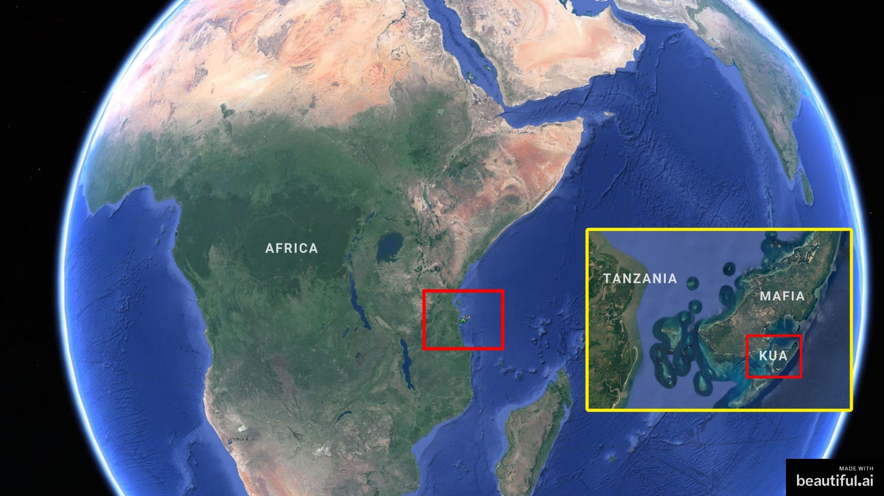
Notes:
World monuments watch 2016 Climate and unmanaged tourism endangering site houses, mosques and a palace

Slide 10
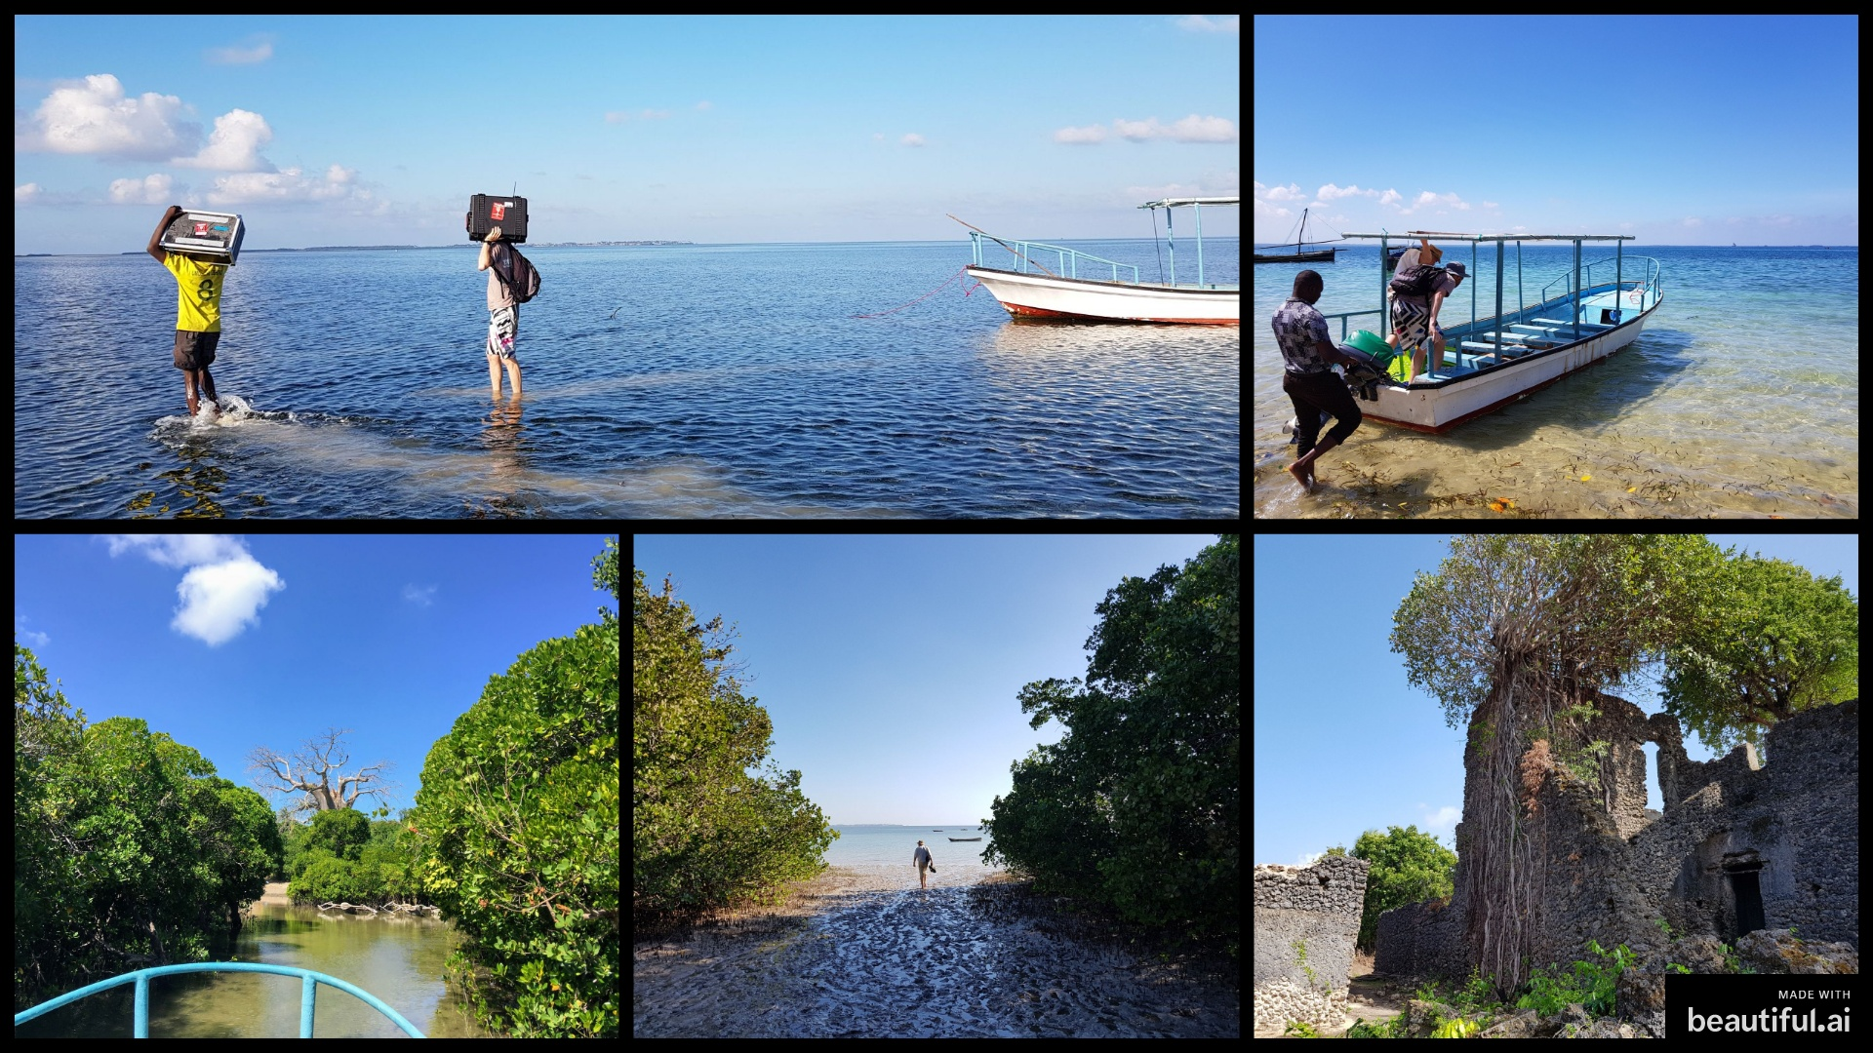
Notes:
Journey to site tricky depending on the tide Some mornings we’d have to walk kms in water to get to the beach, boat couldn’t get there.

Slide 11
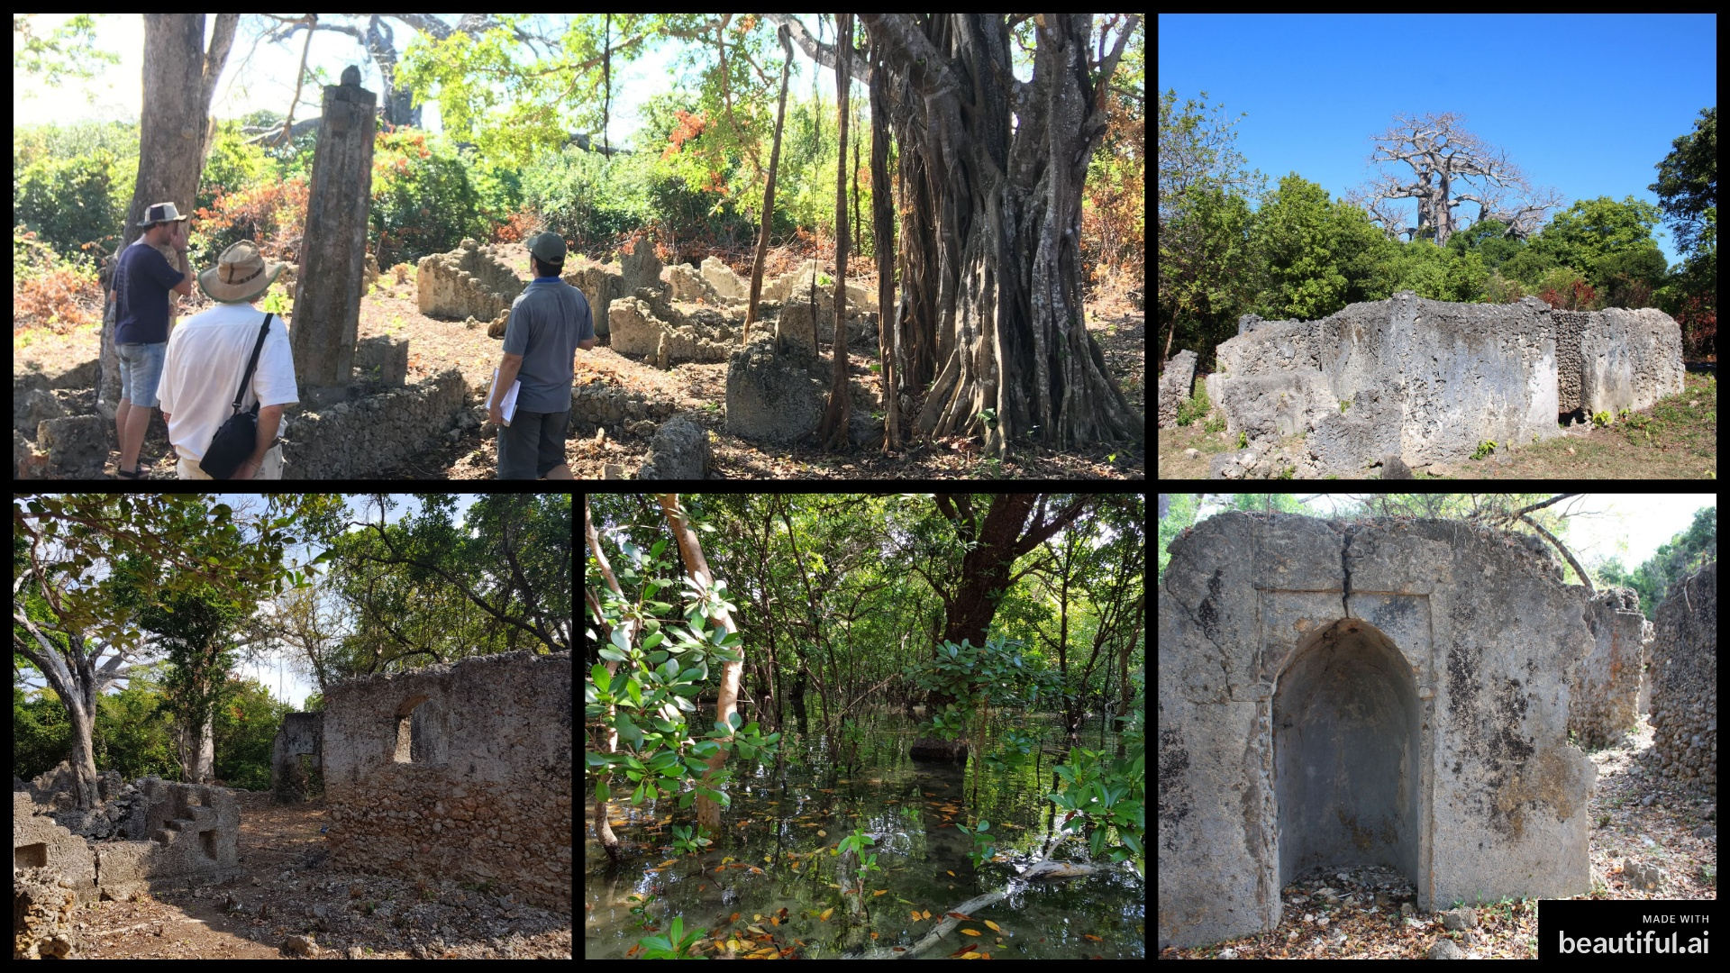
Notes:
Here are some photos to give you an impression of Kua Can see mosques, graves, mangroves

Slide 12
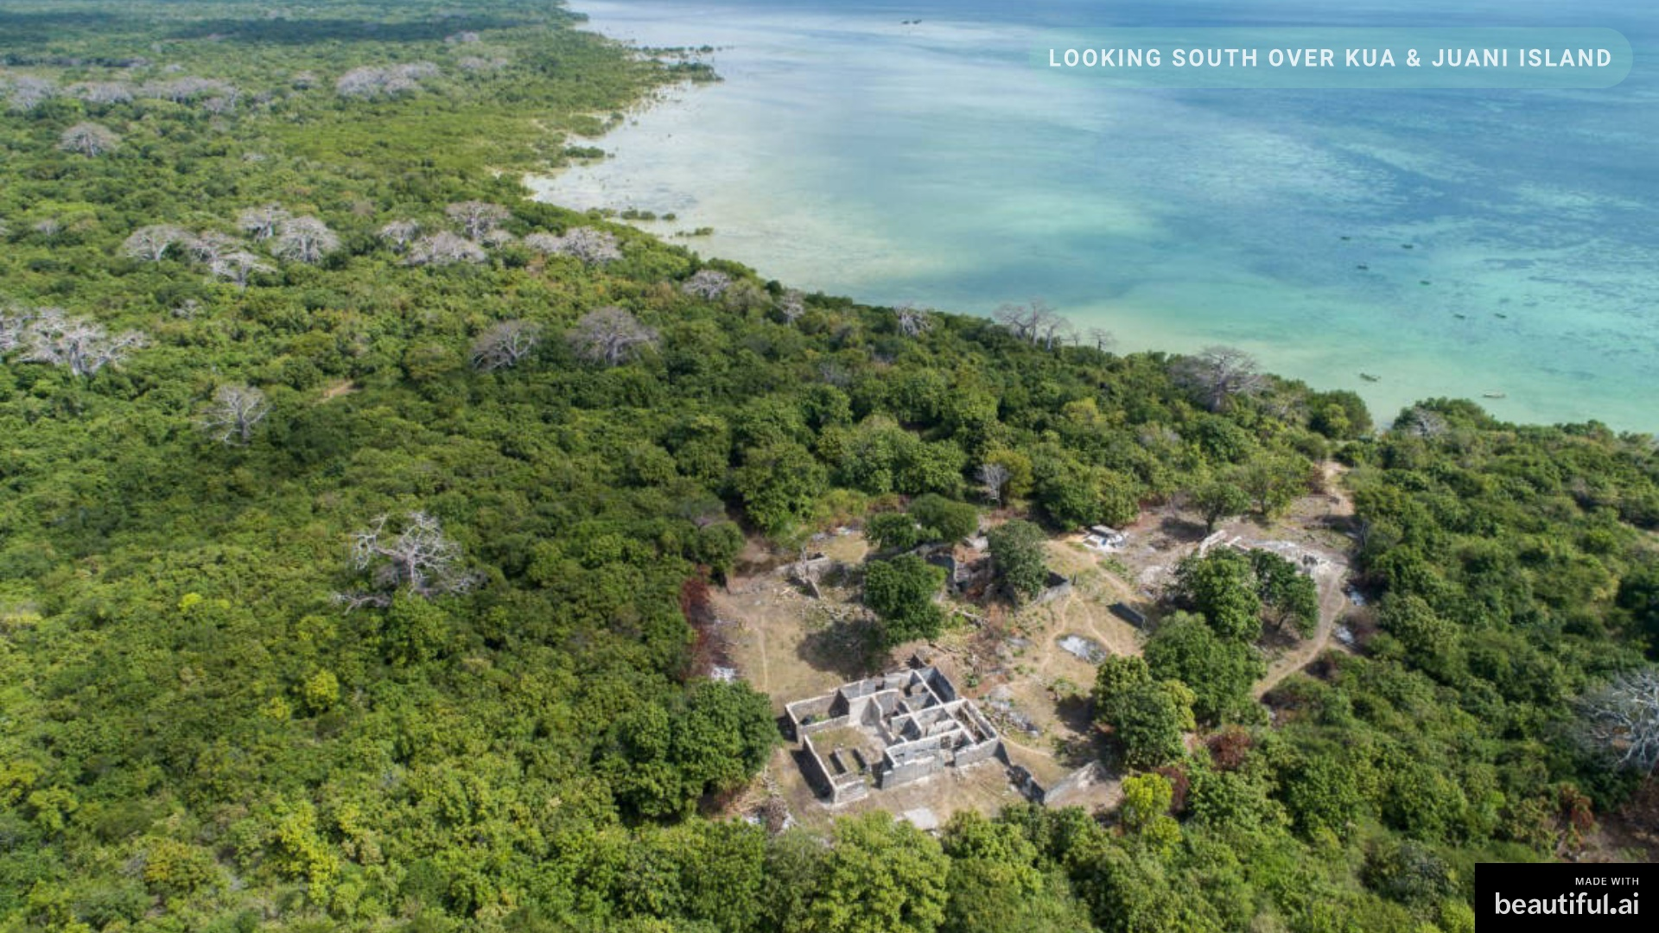

Slide 13
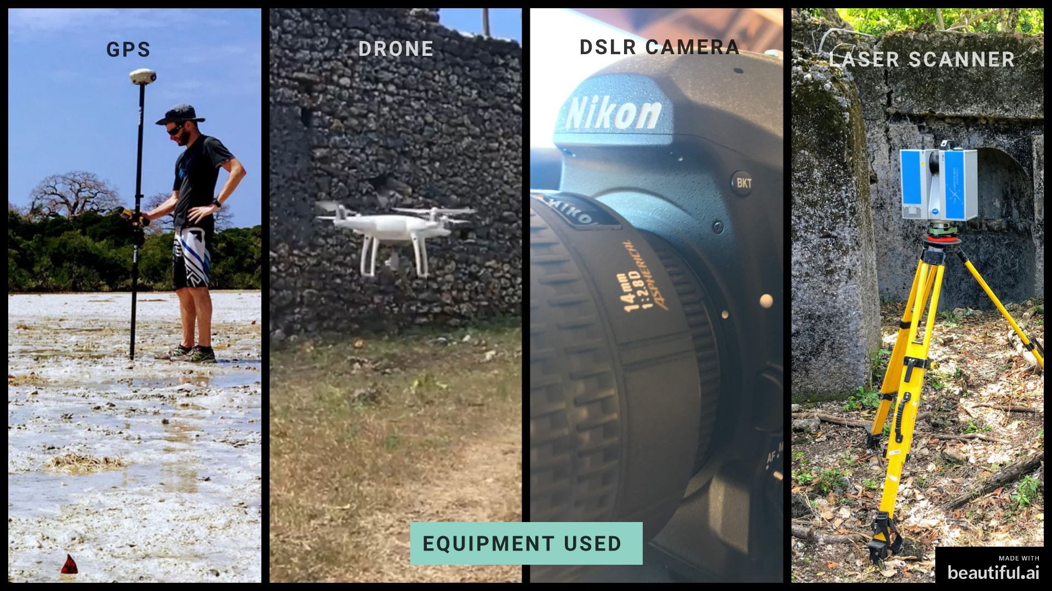
Notes:
Here you can see the equipment we used at Kua I will talk a little more about the drone

Slide 14
Notes:
This is a simplified version of our pipeline for creating colour 3D models

Slide 15
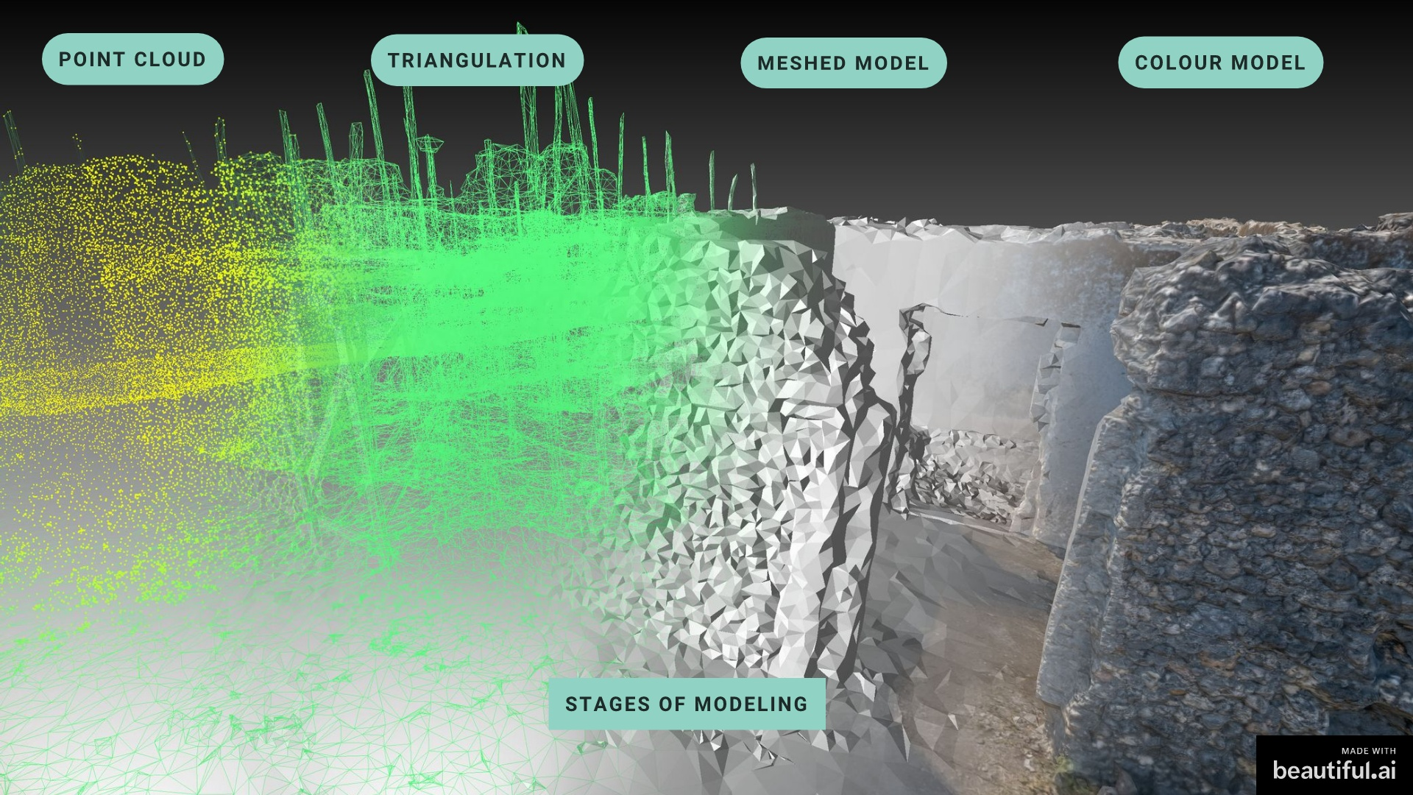

Slide 16
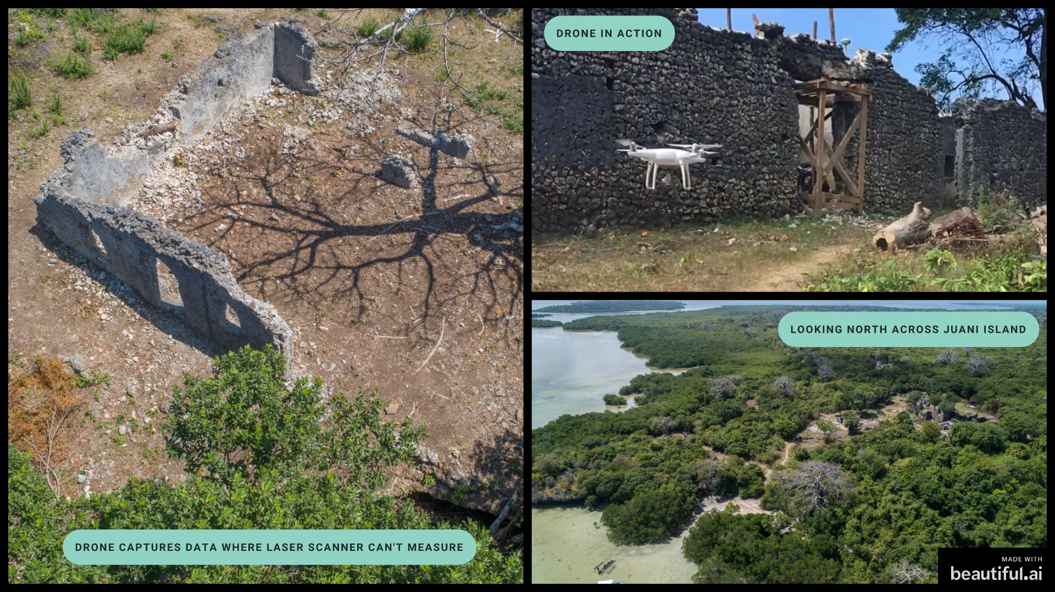
Notes:
DRONE Can capture data where scanner can't measure, where people can't walk or where it's dangerous

Slide 17
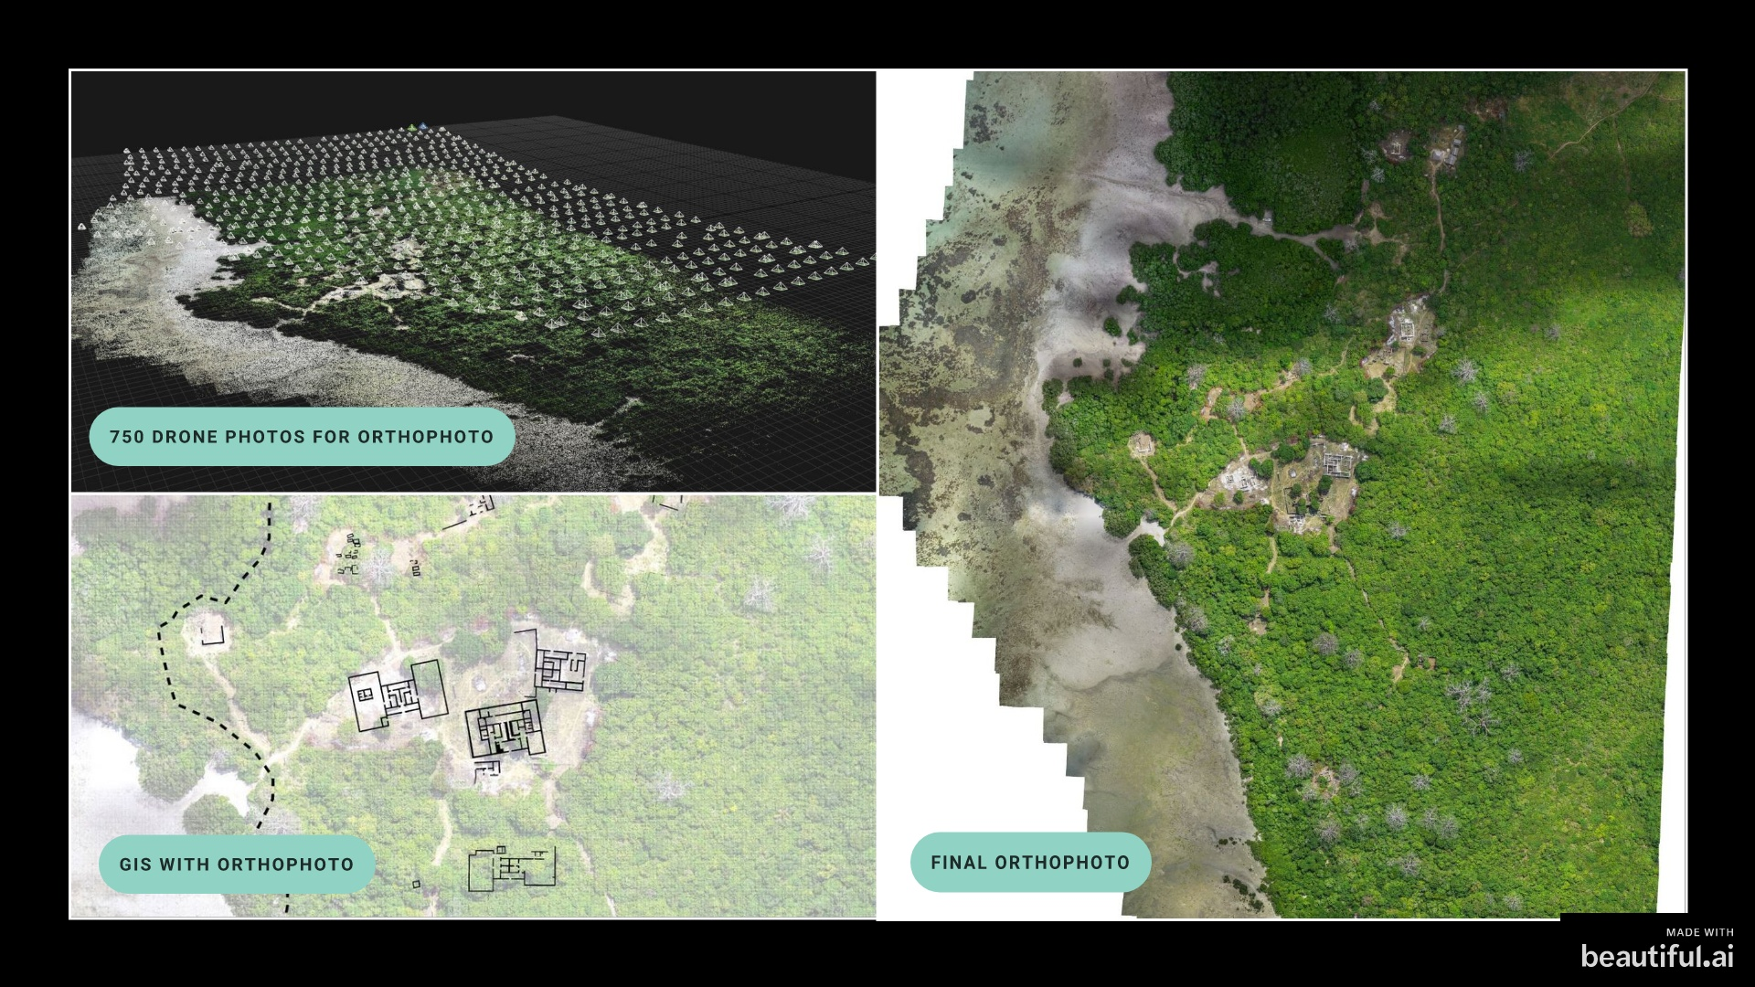
Notes:
We created an orthophoto of Kua. The area is about 600m long and 500m wide. 3cm per pixel flying at altitude of 100m 750 photos SHOW PANO TOUR AND MODEL

Slide 18
Metadata, file management, data management

Slide 19
Zamani Data at UCT
250 structures documented
Worked in 15 countries since 2005
100 TB of Data
Managing & Disseminating so much data is a pain
ZivaHub – University of Cape Town
Contact us directly
The Zamani website
www.jstor.org

Slide 20
Breaking Down Barriers
Ease of sharing data (ZivaHub) in a central hub
No need for asking everytime someone needs data
Licence agreements are clearly defined
Easy download
Discoverability of old & new data
Data storage centralized and backed up properly
Metadata & Open standards.

Slide 21
Some Projects / Uses of Zamani Data

